Slide 1

Algebraic Expressions Basketball!
☺

Slide 2
Get ready to play…Here’s a warm-up!

Slide 3
Simplify:
x+x+x+3+5+9+x

Slide 4
4x+17

Slide 5
Now that you’re warmed up, lets play!!

Slide 6
Jump ball!

Slide 7
Write an algebraic expression for:
The product of 3 and a number added to 12.

Slide 8
3a+12

Slide 9
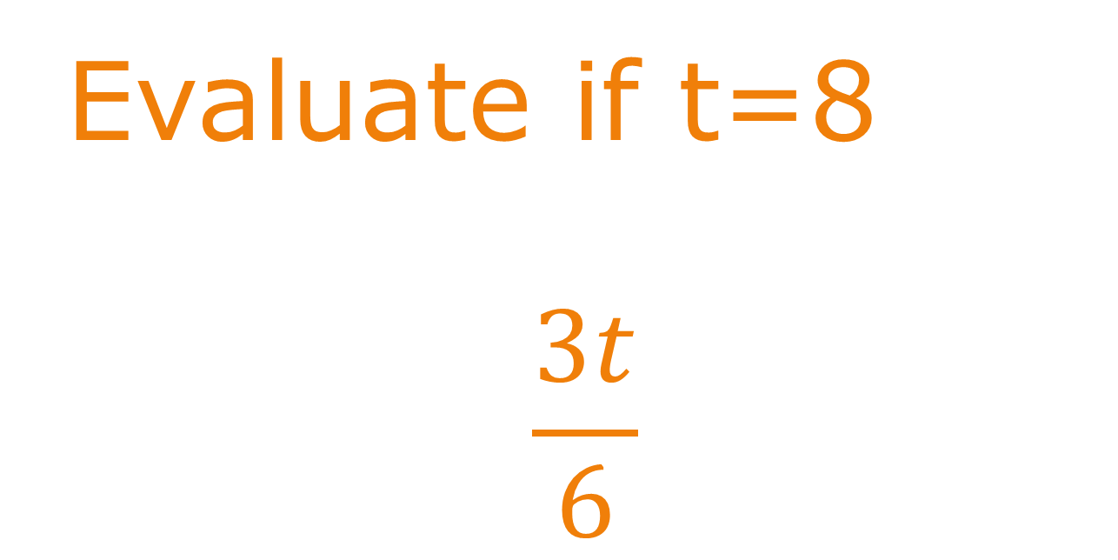
Evaluate if t=8
$$\frac{3t}{6}$$

Slide 10
4

Slide 11
Simplify:
3e+4t-2e-3t

Slide 12
e+t

Slide 13
Evaluate when y=3
9y-10

Slide 14
17

Slide 15
Evaluate:
Subtract 50 from the product of 8e when e=7

Slide 16
6

Slide 17
Simplify:
20+5u+10u-20-14u

Slide 18
u

Slide 19
Simplify:
r+9+10r-5-4r

Slide 20
7r-4

Slide 21
What are the coefficients in the following expression?
20+7k-12+5k+8k

Slide 22
7, 5, and 8

Slide 23
Write an algebraic expression:
Subtract the quotient of g and 3 from the product of 4 and 4.

Slide 24

(4·4)- $\frac{g}{3}$

Slide 25
Mario collected 3x shells. Jasmine collects 10 more shells than Mario. Write the number of shells they collected together in terms of x.

Slide 26
3x+ (3x+10)

Slide 27
Find the perimeter in terms of e
12 cm
e cm
e cm
2e

Slide 28
4e+12

Slide 29
Expand:
5(x – 4)

Slide 30
5x - 20

Slide 31
Factor:
8a + 16

Slide 32
8(a + 2)

