Slide 1
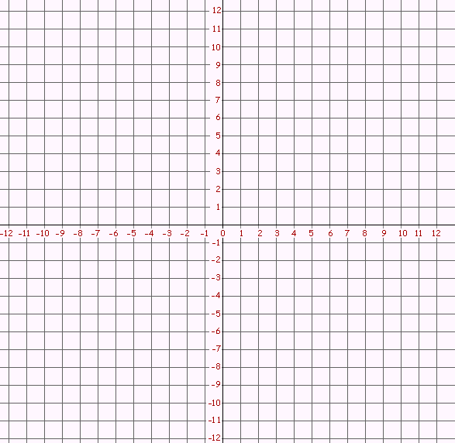
Relations
A __________ is a set of pairs of input and out put values.
There are ______ ways to represent a function.
Ordered Pairs
(input, output)
(x, y)
(-3, 4)
(3, -1)
(4, -1)
(4, 3)
Mapping Diagram
Input Output
Table of Values
Graph
X Input | Y Output
-3 | 4
3 | -1
4 | -1
4 | 3
-3
3
4
4
-1
3

Slide 2
Relations and Functions
The __________ of a relation is the set of inputs, also called the - coordinates, of the ordered pairs
The range is the set of __________, also called the y-coordinates, of the ordered pairs.
A ___________ is a relation in which each element of the domain corresponds with exactly one element of the range.

Slide 3
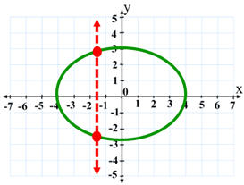
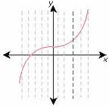
Relations and Functions
____________________ - can be used to determine if a relation is a function.
The vertical-line test states that if a vertical line passes through more than one point on the graph of a relation, then the relation is not a function.

Slide 4
Determine if the relation is a function and explain why or why not.
(2, -3) (3, -1) (4, 3) (2, 3) (6,6)
A function rule is an equation that represents an output value in terms of an ________ value.
Functions Notation – f(x) = 3x +2
Complete the following table.
SHOW ALL WORK!
x input | Function Rule f(x) = -4x + 1 | f(x) Output
-2
0
5

Slide 5
The ___________________, x, represents the input of a function.
The ___________________, f(x), represents the _______ of a function.
How do you write f of -2? ___________
In the previous table, what did f of -2 equal? Explain.
9; it is the __________ of the function f for the input -2

Slide 6
x input | Function Rule f(x) = 2x – 6 | f(x) Output
-2
0
3
Complete the table above. Show work! Then list the independent and dependent variables.
Independent Variables
Dependent Variables

Slide 7
Tickets to a concert are available online for $35 each plus a handling fee of $2.50. The total cost is a function of the number of tickets bought. What function rule models the cost of the concert tickets? Evaluate the function for 4 tickets.
Step 1: Determine dependent and independent quantities
Cost is the ________________ quantity and the number of tickets is the _______________ quantity.
Step 2: Relate
Step 3: Define
Let = # of tickets bought
let = the total cost
Step 4: write
= x + ➔ c(t) = 35(t) + 2.50
c(4) = 35(4) + 2.50 ➔ 140 + 2.50 ➔ 142.50
The cost of 4 tickets is $142.50
Total Cost
is
Cost per Ticket
times
# of Tickets Bought
plus
Handling Fee
t
C(t)

Slide 8
Writing and Evaluating a Function
Write a function rule to model the cost per month of a long-distance cell phone-calling plan. Then evaluate the function for the given number of minutes.
Monthly service fee: $4.52
Rate: $0.12 per minute
Minutes used: 250 and Minutes used: 160

Slide 9
Writing and Evaluating a Function
Write a function rule to model the cost per month of a long-distance cell phone-calling plan. Then evaluate the function for the given number of minutes.
Monthly service fee: $3.12
Rate: $0.18 per minute
Minutes used: 175 and minutes used: 215

