Slide 1

Strive for the Five!
Using TI Technology to Prepare for the AP® Precalculus Exam
education.ti.com/webinars

Slide 2
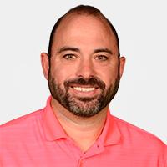
education.ti.com/webinars | Strive for the Five! Using TI Technology to Prepare for the AP® Precalculus Exam
Host
Presenter
Presenter
Michael Houston
Katie Martinez
Karen Sleno
T^{3™} National Instructor
New Castle, Pennsylvania
@mikehouston33
T³™ Regional Instructor
Flushing, MIchigan
T³™ National Instructor
Encinitas, California

Slide 3


education.ti.com/webinars | Strive for the Five! Using TI Technology to Prepare for the AP® Precalculus Exam
Agenda
Welcome & Introductions
What calculator skills do students need for the APPC exam?
FRQ1 and the TI-84 Handheld
Multiple Choice Questions and the TI-84 Handheld
FRQ2 and the TI-Nspire Handheld
Multiple Choice Questions and the TI-Nspire Handheld
Webinar Drawing

Slide 4

education.ti.com/webinars | Strive for the Five! Using TI Technology to Prepare for the AP® Precalculus Exam
Expected Outcomes
I CAN use TI technology to visualize a problem and its possible solutions.
I CAN connect a verbal representation with a graphical image.
I CAN construct various tools using technology to solve problems.
I CAN explain my results in the context of a problem.

Slide 5
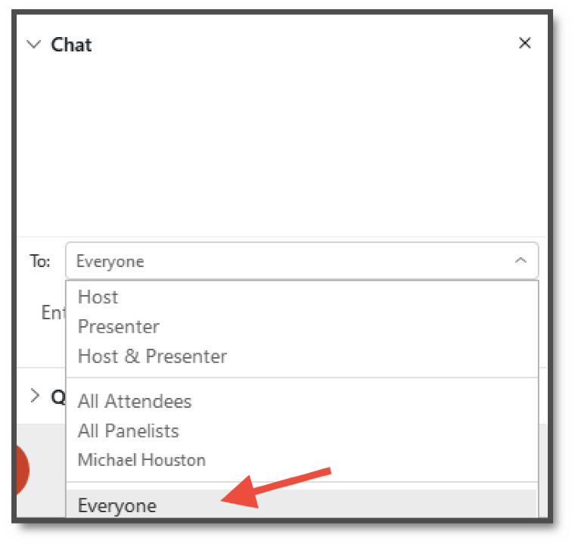

education.ti.com/webinars | Strive for the Five! Using TI Technology to Prepare for the AP® Precalculus Exam
WebEx Chat & Poll Features
Use the chat window to send general messages.
Open the chat window with the messaging icon at the bottom of your screen
Send to chats “everyone”. Please feel free to ask questions during the presentation!
The Q&A and chat windows are located on the right side of your screen.
Later, we will use the poll feature, also found on the lower right side of your screen.

Slide 6
education.ti.com/webinars | Strive for the Five! Using TI Technology to Prepare for the AP® Precalculus Exam
Calculator Skills
Storing and recalling function equations
Storing and recalling calculated values
Using the intersection tool to solve equations
Finding regression equations
Using tables of values to determine function types
Graphing functions and setting viewing windows
Finding zeros of a function

Slide 7
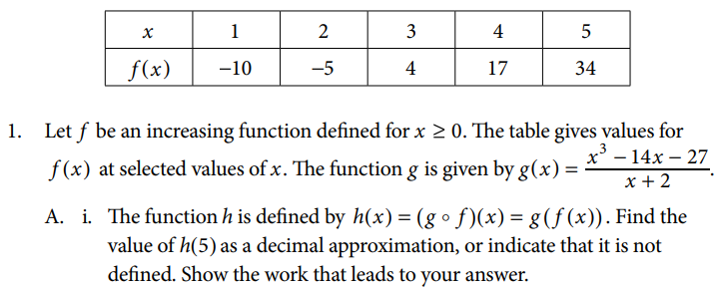
education.ti.com/webinars | Strive for the Five! Using TI Technology to Prepare for the AP® Precalculus Exam
Examining FRQ 1 Part A

Slide 8
education.ti.com/webinars | Strive for the Five! Using TI Technology to Prepare for the AP® Precalculus Exam
Examining FRQ 1 Part B
Notes:
What approaches would you use to solve this problem?

Slide 9
education.ti.com/webinars | Strive for the Five! Using TI Technology to Prepare for the AP® Precalculus Exam
Examining FRQ 1 Part C
Notes:
TI-84. Use table feature and examine the differences in the outputs for common differences.
What do you notice about the values in the table?

Slide 10
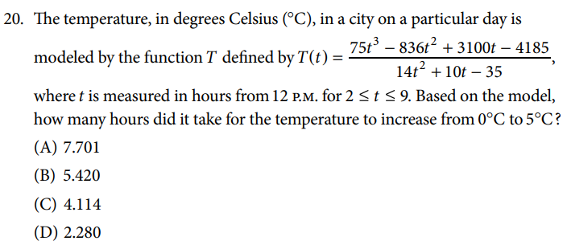
education.ti.com/webinars | Strive for the Five! Using TI Technology to Prepare for the AP® Precalculus Exam
CED #20
Notes:
What kind of misconceptions do you think student would run into with this problem?
Put function equation into handheld
Set window for restricted domain
Find zero
Show how to store x-value of zero as new variable (ex: store as ‘a’)
Find intersection of function with y = 5 and show how to store x-value of intersection as new variable (ex: store as ‘b’)
On home screen calculate b-a.

Slide 11
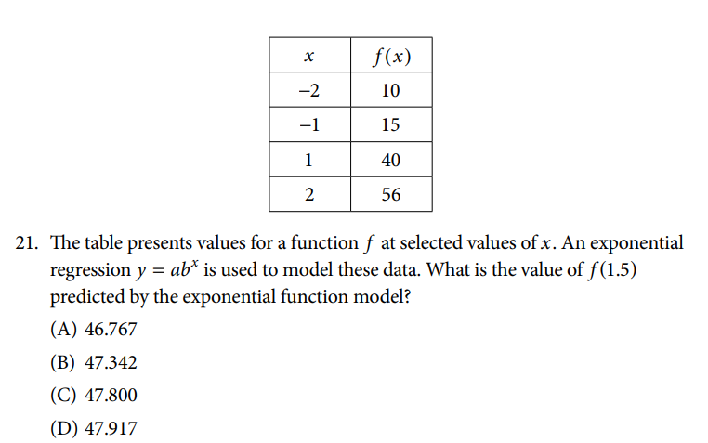
education.ti.com/webinars | Strive for the Five! Using TI Technology to Prepare for the AP® Precalculus Exam
CED #21
Notes:
Use TI-84 to run/store regression equation and evaluate stored regression function

Slide 12
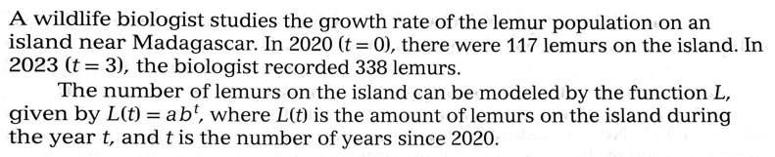


education.ti.com/webinars | Strive for the Five! Using TI Technology to Prepare for the AP® Precalculus Exam
Taken from Fast Track to a Five
Authors: Kelly Hemmerling and Crissie Ricketts
Deep Dive into FRQ 2
Notes:
TI-Nspire
Run/store regression (DISCUSS type of functions that regression CANNOT be used for)
Calculate AROC on calculator screen and store as variable
Show graph of regression equation and draw secant line to visually show answer to part B (iii)

Slide 13
education.ti.com/webinars | Strive for the Five! Using TI Technology to Prepare for the AP® Precalculus Exam
Taken from Fast Track to a Five
Authors: Kelly Hemmerling and Crissie Ricketts
Deep Dive into FRQ 2
Notes:
TI-Nspire
Run/store regression (DISCUSS type of functions that regression CANNOT be used for)
Calculate AROC on calculator screen and store as variable
Show graph of regression equation and draw secant line to visually show answer to part B (iii)

Slide 14
When is regression appropriate in FRQ2?
education.ti.com/webinars | Strive for the Five! Using TI Technology to Prepare for the AP® Precalculus Exam
Taken from Fast Track to a Five
Authors: Kelly Hemmerling and Crissie Ricketts
Deep Dive into FRQ 2
APPROPRIATE
(AP Classroom Practice Exam 1)
(AP Classroom Practice Exam 2)
(AP Classroom Practice Exam 3)
NOT APPROPRIATE
(CED Sample Exam)
(2024 AP Precalculus Exam)
Notes:
TI-Nspire
Run/store regression (DISCUSS type of functions that regression CANNOT be used for)
Calculate AROC on calculator screen and store as variable
Show graph of regression equation and draw secant line to visually show answer to part B (iii)

Slide 15
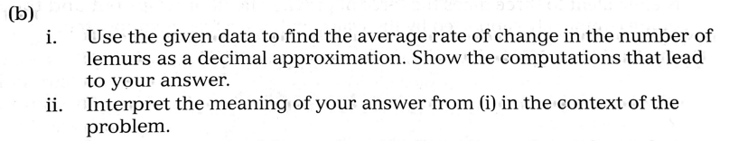

education.ti.com/webinars | Strive for the Five! Using TI Technology to Prepare for the AP® Precalculus Exam
Taken from Fast Track to a Five
Authors: Kelly Hemmerling and Crissie Ricketts
Deep Dive into FRQ 2
The rate of change is POSITIVE so the number of lemurs is increasing
This rate of increase is valid from 2020 until 2023.
Notes:
TI-Nspire
Run/store regression (DISCUSS type of functions that regression CANNOT be used for)
Calculate AROC on calculator screen and store as variable
Show graph of regression equation and draw secant line to visually show answer to part B (iii)

Slide 16
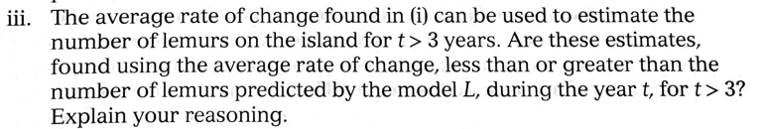
education.ti.com/webinars | Strive for the Five! Using TI Technology to Prepare for the AP® Precalculus Exam
Taken from Fast Track to a Five
Authors: Kelly Hemmerling and Crissie Ricketts
Deep Dive into FRQ 2
Notes:
TI-Nspire
Run/store regression (DISCUSS type of functions that regression CANNOT be used for)
Calculate AROC on calculator screen and store as variable
Show graph of regression equation and draw secant line to visually show answer to part B (iii)

Slide 17
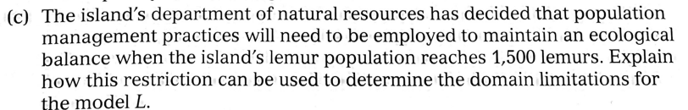
education.ti.com/webinars | Strive for the Five! Using TI Technology to Prepare for the AP® Precalculus Exam
Taken from Fast Track to a Five
Authors: Kelly Hemmerling and Crissie Ricketts
Deep Dive into FRQ 2
Notes:
TI-Nspire
Run/store regression (DISCUSS type of functions that regression CANNOT be used for)
Calculate AROC on calculator screen and store as variable
Show graph of regression equation and draw secant line to visually show answer to part B (iii)

Slide 18
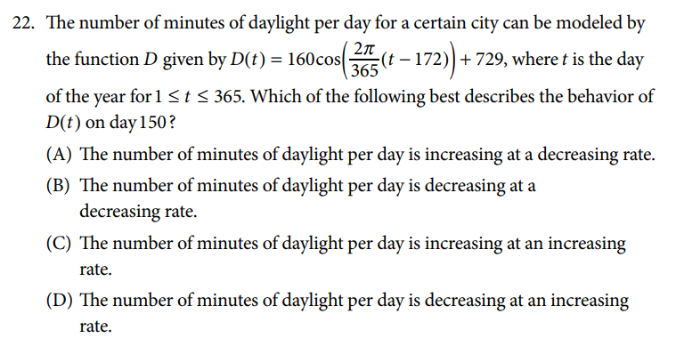
education.ti.com/webinars | Strive for the Five! Using TI Technology to Prepare for the AP® Precalculus Exam
CED #22
Notes:
Graph function
Change window
Trace to day 150

Slide 19
education.ti.com/webinars | Strive for the Five! Using TI Technology to Prepare for the AP® Precalculus Exam
What are the takeaways?
Students analyze math visually…encourage them to see the picture with technology first!
Promote technology as a means to quick problem solving
Students should be comfortable with their technology tools and when they are appropriate to use
Key skills:
  Storing values
  Finding intersections, extrema, roots
  Creating graphs
  Regression/residuals

Slide 20


education.ti.com/webinars | Strive for the Five! Using TI Technology to Prepare for the AP® Precalculus Exam
Thanks and Q&A
Questions on anything covered today?

Slide 21



education.ti.com/webinars | Strive for the Five! Using TI Technology to Prepare for the AP® Precalculus Exam
Share What You’re Learning Today
@TICalculators
#T3Learns
Join the TI Teacher Community
conversation on Facebook!

Slide 22
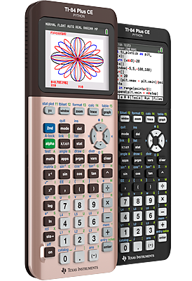
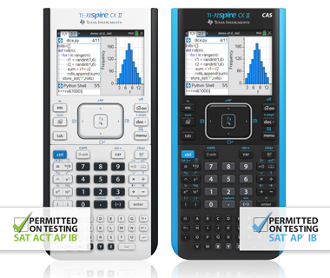
education.ti.com/webinars | Strive for the Five! Using TI Technology to Prepare for the AP® Precalculus Exam
Webinar Drawing
One lucky winner receives a TI graphing calculator!
Choose from:
TI-84 Plus CE Python
TI-84 Plus CE
TI-Nspire™ CX II
TI-Nspire™ CX II CAS
And the winner is …

Slide 23


education.ti.com/webinars | Strive for the Five! Using TI Technology to Prepare for the AP® Precalculus Exam
Download Your Certificate of Attendance
https://bit.ly/3ZrJoVa

Slide 24

education.ti.com/webinars | Strive for the Five! Using TI Technology to Prepare for the AP® Precalculus Exam
Post-Webinar Follow-up
Find useful resources, answers to your questions and access to friendly, knowledgeable customer support and technical reps.
General Questions: 1.800.TI.CARES
Technical Questions: 972.917.8324 or ti-cares@ti.com
For a consultation on an upcoming purchase
of TI Technology or professional development, please contact us at: ti-educators@ti.com

Slide 25



education.ti.com/webinars | Kickstart AP® Precalculus: Fresh Strategies for Exploring Polynomials and Rates of Change
Upcoming Webinars and Survey
Register for upcoming webinars
education.ti.com/webinars
Tell us how we did
Right after this session, you will receive a survey. We appreciate your feedback so that we can improve future events.

Slide 26

Thank you
education.ti.com/webinars | Strive for the Five! Using TI Technology to Prepare for the AP® Precalculus Exam

