Slide 1

Geometry envision
Release Day
Geometry enVision Lesson 10-4 Inscribed Angles

Slide 2
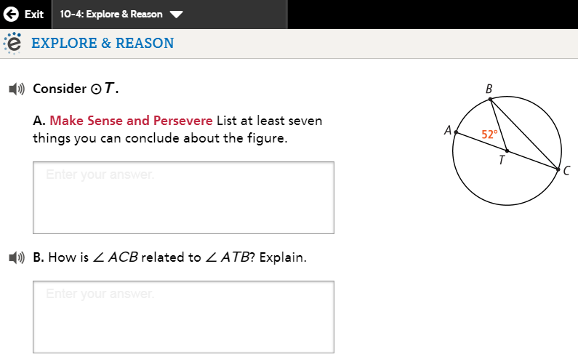

Slide 3
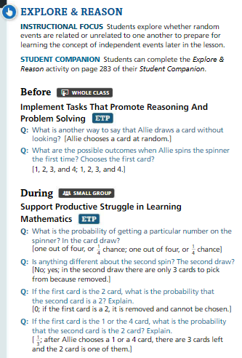
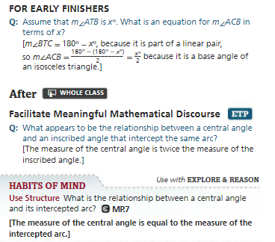

Slide 4
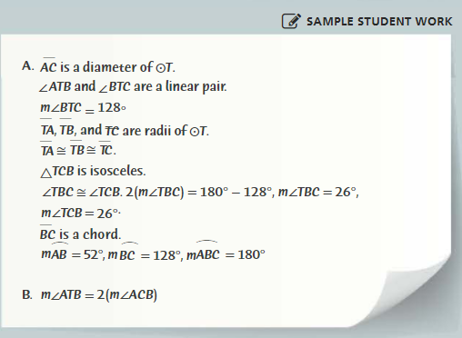

Slide 5
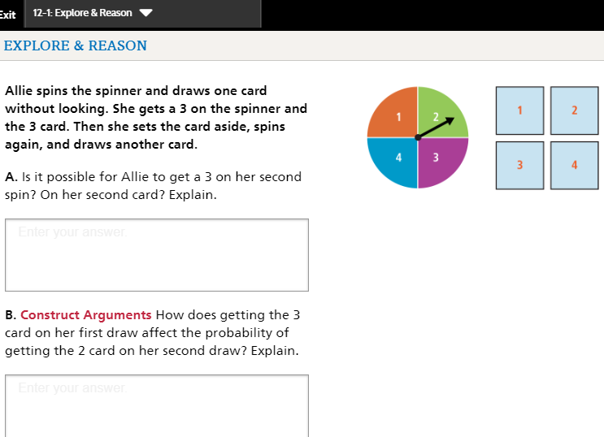

Slide 6
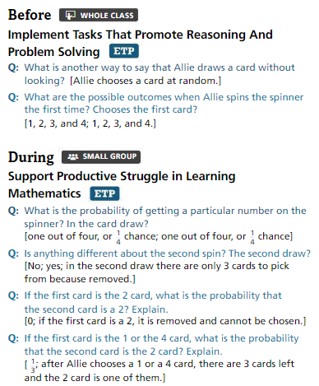
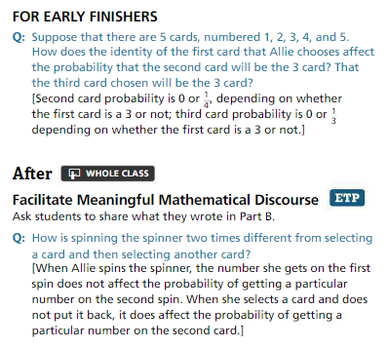

Slide 7
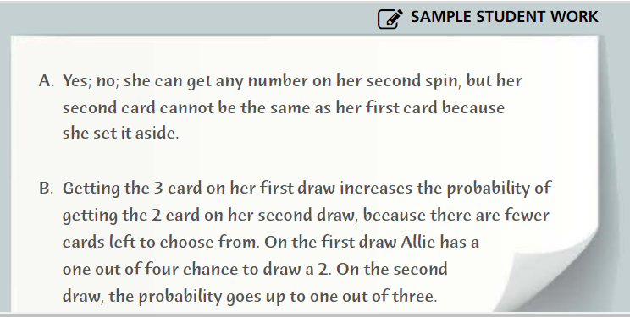

Slide 8
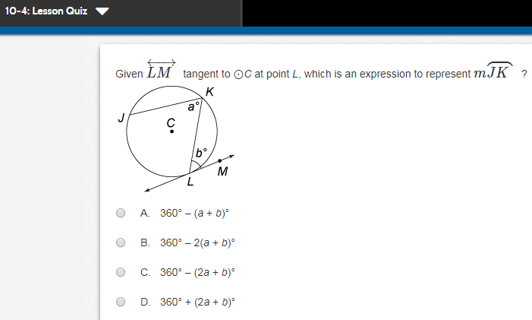
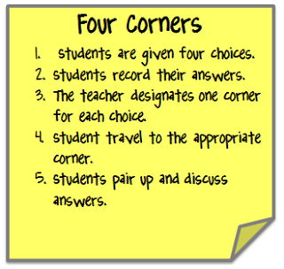
Let’s play commit and toss.
Write your answer and show your work on a post-it, do NOT write your name.

Slide 9
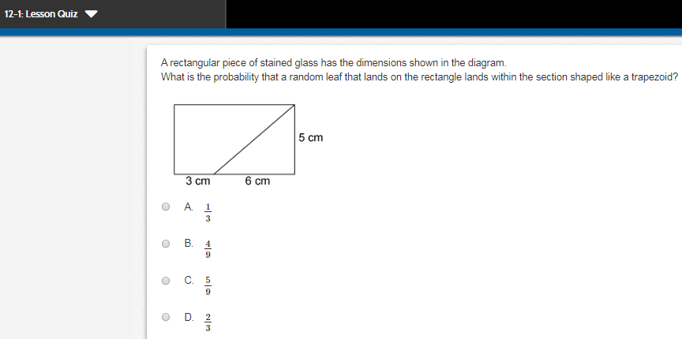
Let’s play commit and toss.
Write your answer and show your work on a post-it, do NOT write your name.

Slide 10
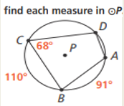
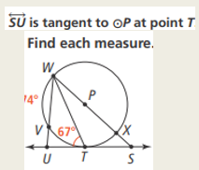
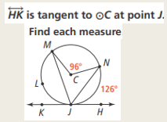
Quiz, Quiz Trade, or Showdown Cards
Geometry Lesson 10-4

Slide 11
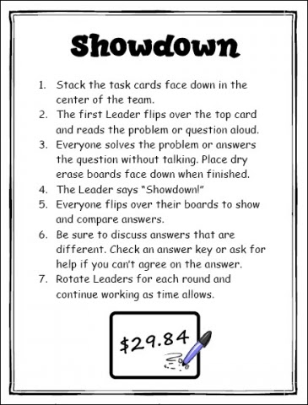
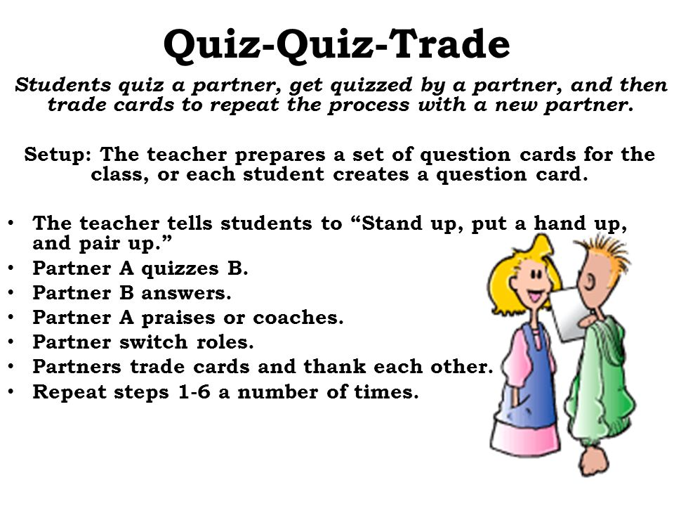

Slide 12



Quiz, Quiz Trade, or Showdown Cards
Probability Lesson 12-1

Slide 14
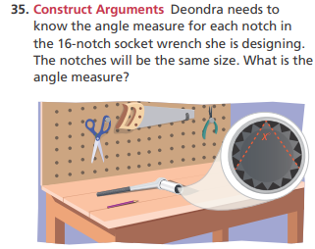
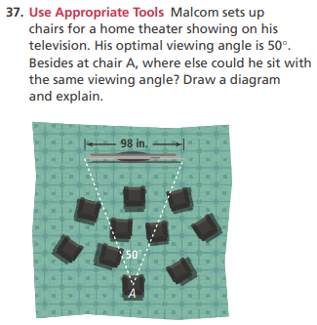
Numbered Heads Together, or Think, Pair, Share
Geometry Lesson 10-4

Slide 15
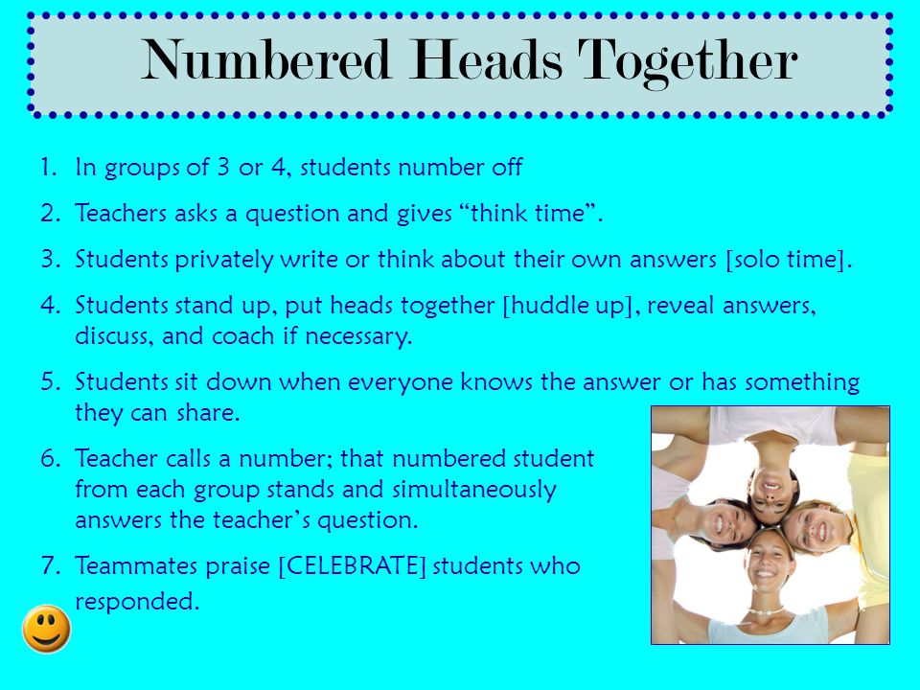
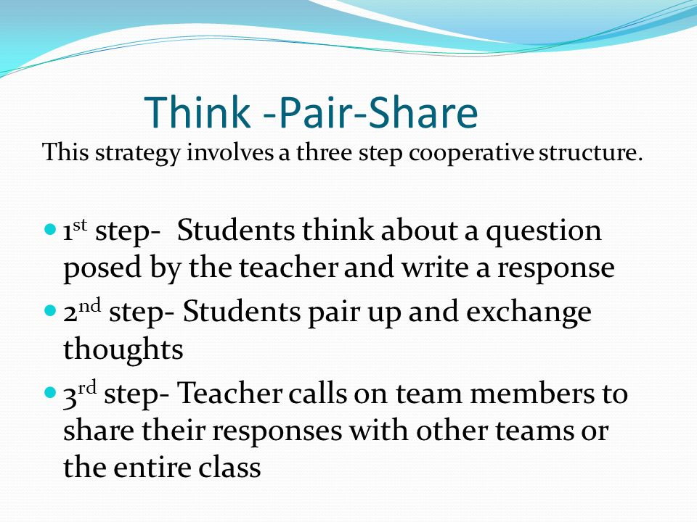

Slide 16
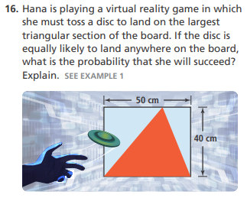
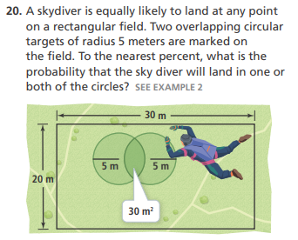
Numbered Heads Together, or Think, Pair, Share
Probability Lesson 12-1

Slide 18


