Slide 1


Exploring Olympic Sports Data
Gymnastics, Diving, and Trampoline
Qualifying Results from the 2021 Olympics
Special thanks to:
Riley Loos, Stanford ‘23
MS&E - Operations & Analytics
Copyright Ⓒ 2024 youcubed. All rights reserved.

Slide 2
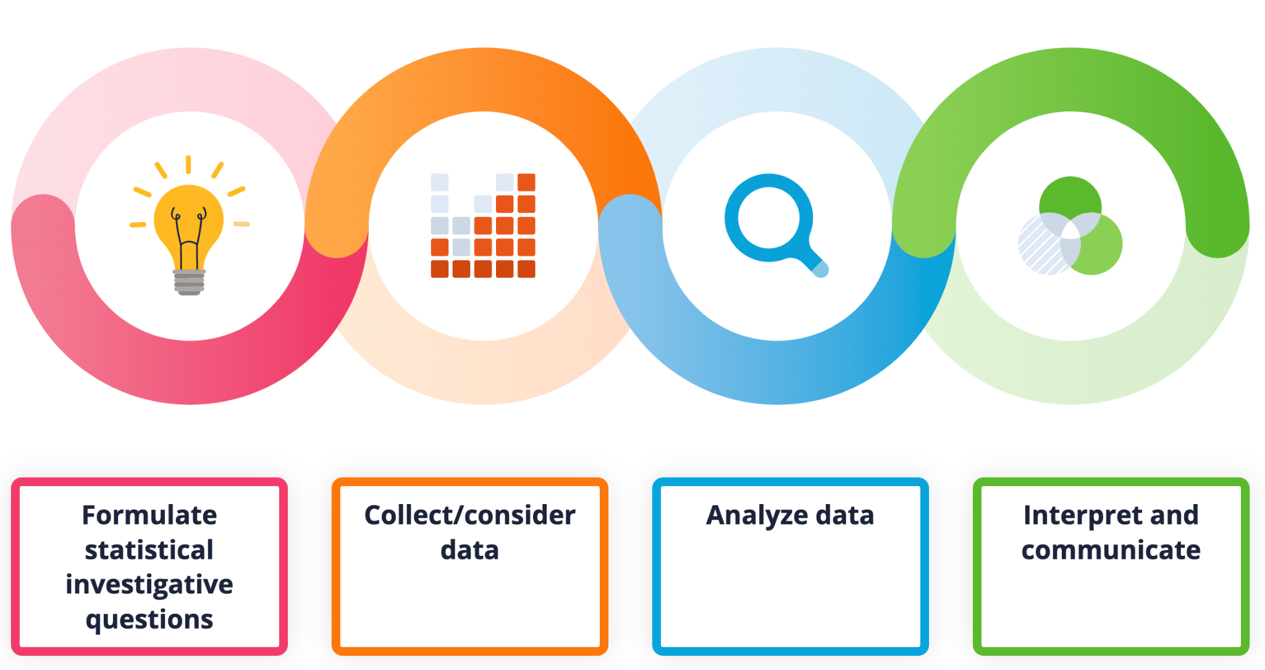
Exploring Olympic Sports Data
T
In this task, students will have an opportunity to work through the data science process of formulating questions, considering data, analyzing data, and interpreting and communicating. They will do this within the context of Olympic sports. Students will explore qualifying results from gymnastics, diving, and trampoline from the 2021 Olympics. These three sports, though distinct, share a common thread – they are all judged by experts and involve intricate interplays of difficulty and execution scores. By merging them into a unified dataset, students can explore trends that span across these disciplines.
Materials
Olympic Sports CODAP Link
Key to Olympic Sports Data
CODAP tutorials
  Getting started with CODAP, Part 1: Plotting Two Variables
  Getting started with CODAP, Part 2: More Advanced Features
Google Slides
Optional: Data set in Google Sheets

Slide 3
Exploring Olympic Sports Data
T
Launch: Olympic Sport Video
Ask students if they have watched gymnastics, diving or trampoline in the Olympics. Ask them what they know about these sports. Show students the video introducing gymnastics, diving, and trampoline.
Ask students: What do you notice? What do you wonder?
Play the video for students:
Link to video in Vimeo. You can use this link if you want to download the video or play the video with captions. Another option is to play the video on the next slide directly.

Slide 4

Exploring Olympic Sports Data
S
What do you notice? What do you wonder?

Slide 5
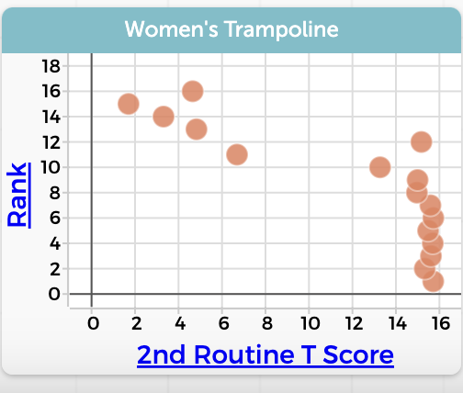
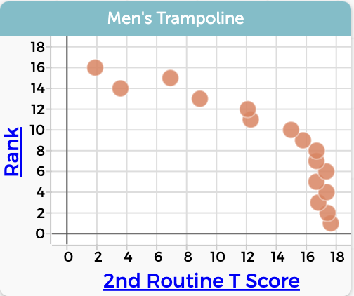
Exploring Olympic Sports Data
T
Launch: Olympic Sport Data Talk
Ask students what they notice and wonder about the visual. What story does the visual tell? What additional data might they be interested in exploring?
Let students know they will have an opportunity to explore data for the preliminary competition results for the 2021 Olympics in gymnastics, diving, and trampoline. Let them know that we have chosen gymnastics, diving and trampoline to explore because of the similarities across judging and scoring for the three sports.
*Here are links for additional information on number talks and dot talks.

Slide 6
Exploring Olympic Sports Data
S
Olympic Sport Data Talk
What do you notice? What do you wonder? What story does this visual tell? What additional data would you be interested in exploring?
Note: T Score is how long competitors are in the air in seconds.

Slide 7
Exploring Olympic Sports Data
T
Launch: Data Science Process
Share with students that they will be working through the data science process with data from the preliminary competition results for the 2021 Olympics in gymnastics, diving, and trampoline. They will explore the data set to see what data is available, and they will formulate some questions based on the data available. They will then make graphs with the data, analyze their findings, and finally interpret and communicate their results. (More information here.)

Slide 8
Exploring Olympic Sports Data
S
Data Science Process

Slide 9
Exploring Olympic Sports Data
T
Formulating questions given the data
Give each group of students the link to the data in CODAP and a key to the Olympic Data. Ask students to look through the variables in the table in CODAP and the key to clarify what data is available. Students may need to research a category further to understand what it is. Encourage them to do that at this time.
As students explore the data, ask them what questions they might ask of the data that are interesting to them. For example, do the athletes ranked higher spend more time in the air? Ask students to brainstorm questions that look at one sport and also questions that look across sports. Have students record the questions they are interested in exploring on a poster. This is a time to generate questions rather than to narrow down to two questions. As you look at students questions, encourage them to pick questions that can be answered by the data.
Come back together as a class and allow students to walk from group to group to look at the posters each group created. As groups look at other posters, encourage them to discuss with each other which questions they are interested in exploring as a group. After the gallery walk, ask students which questions were especially interesting to them and to consider if they can be answered with the data given. Have students make note of the questions they want to explore further.

Slide 10
Exploring Olympic Sports Data
S
Formulating Questions
As a group:
Open the data in CODAP. Look through the variables available in the tables in CODAP and look through the key to the Olympic Data. Clarify your understanding of what data is available. Feel free to do a search on topics that need clarification.
Brainstorm questions you can ask of the data. Generate questions that can be asked across the three sports and also questions that you could ask of one sport. Record the questions you generate on a poster paper.
Note: Make sure your questions can be answered with the data given.

Slide 11
Exploring Olympic Sports Data
T
Analyzing and Interpreting Data
Ask students to pick one question to explore that can be answered with one sport’s data and another question that can be answered across two or three sports from the brainstormed list.
Let students know that they will be moving into the phases of analyzing and interpreting the data. In this phase, they will create visuals of the data and consider what these visuals communicate about the data.
Give students the link to the data in CODAP. If your students have not used CODAP before there are two tutorials they can work through if they would like to. You can decide if you give those alongside the task or give students some separate time to explore CODAP using the tutorial.
As students work on the task and create graphs of the data they may decide to change their question. Let students know that this is part of the iterative nature of the data science process.
Have students share their questions, graphs, and interpretations on a class set of google slides.

Slide 12
Exploring Olympic Sports Data
S
Analyzing and Interpreting Data
As a group:
Decide as a group which two questions you would like to explore: one from one sport and one across 2-3 sports.
Create visuals of the data using CODAP. What story do the visuals tell?
  As you are exploring, you may decide you may want to ask a different question of the data
Add your questions, visuals, and interpretation to a slide in a class slideshow.
CODAP Tutorials:
Getting started with CODAP, Part 1: Plotting Two Variables
Getting started with CODAP, Part 2: More Advanced Features

Slide 13
Exploring Olympic Sports Data
T
Gallery Walk
Give groups time to look at other groups slides. Ask them to consider the following questions:
What questions did the other groups explore?
What were their findings?
How are their findings supported by their visuals?
How were they similar or different from your findings?
What would you like to explore further?
Debrief their findings as a whole class. Consider asking your students:
What did you discover as you explored this data?
What did this make you want to explore further?
Were there questions you had that couldn’t be answered by this data?
How might data analysis be useful for sports in general?

Slide 14
Exploring Olympic Sports Data
S
Gallery Walk
As a group:
Look at the slides from other groups
  What questions did they explore?
  What were their findings?
  How are their findings supported by their visuals?
  How were they similar or different from your findings?
  What would you like to explore further?

