Slide 1
Solving Linear Equations in One Variable
A Formative Assessment Lesson
Notes:
The FAL Solving Linear Equations in One Variable can be found here: https://www.map.mathshell.org/download.php?fileid=1686

Slide 2
Let’s get started!

Slide 3
True or False?
4x + 1 = 3
Can you give me a value for x that makes this equation false?
Show the calculations that explain this answer.

Slide 4
True or False?
4x + 1 = 3
Can you give me a value for x that makes this equation true?
Show the calculations that explain this answer.

Slide 5
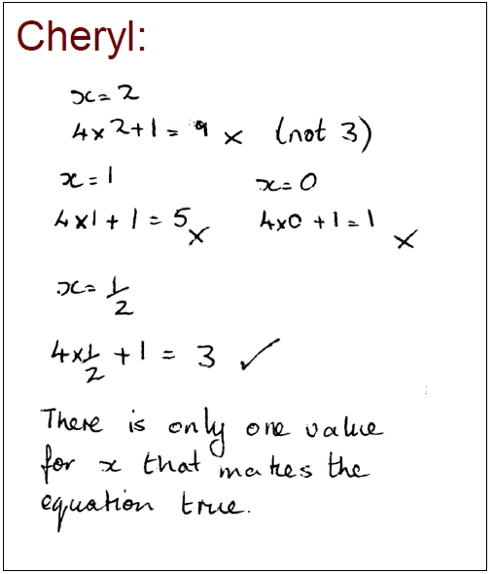
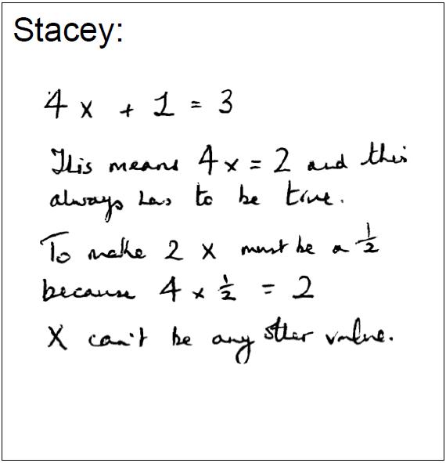
How many different values of x make the equation true?

Slide 6
Always, Sometimes, or Never True?
You wil be given a set of cards.
Group the equations by their type of solution:
Always True Sometimes True Never True
If you think the equation is sometimes true, be prepared to give values of x for which it is true and for which it is false.
If you think the equation is always true or never true, be prepared to explain how you can be sure this is the case.

Slide 7
Let’s see what you learned.
See your teacher for a quick formative assessment.

