Slide 1
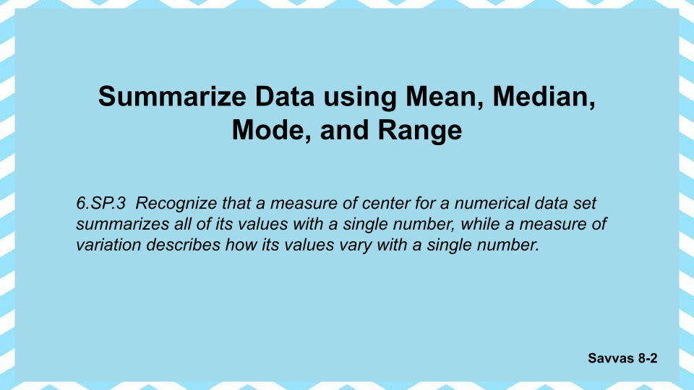

Slide 2
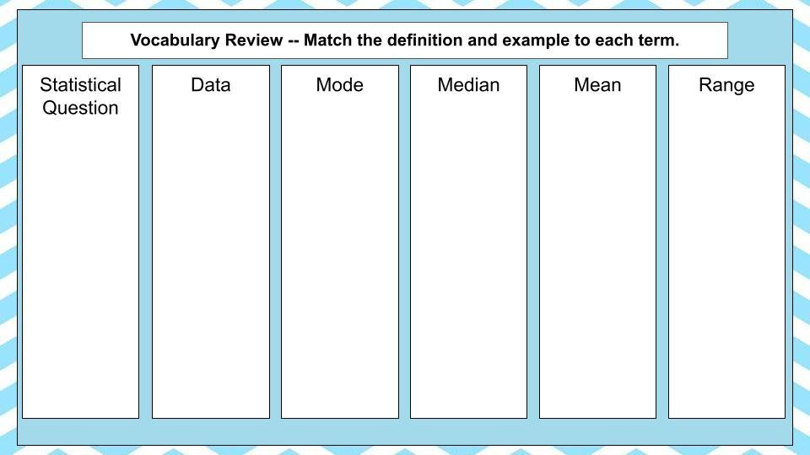
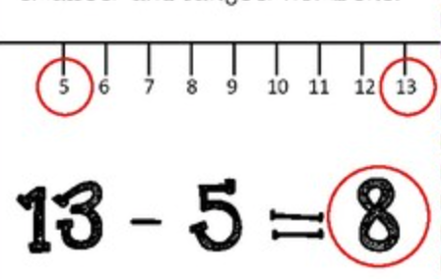
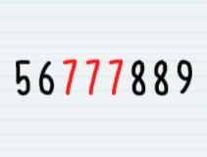
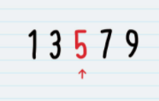
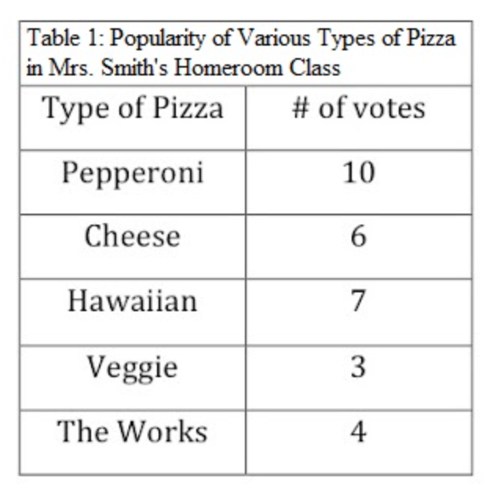
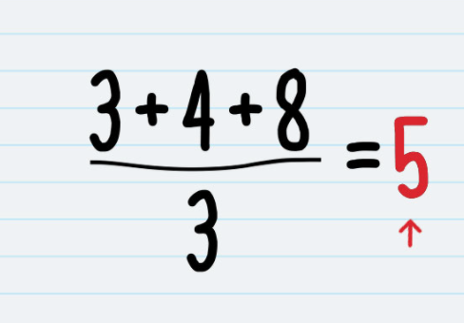
The number that shows up the most
Facts or information that can be analyzed.
A question that has a variety of answers.
A value that tells how spread out the data is.
Largest value minus the smallest value.
The number you get from adding a set of numbers and then dividing by amount of numbers in the set; average.
Example: What time do my classmates go to sleep?
The number in the middle of an ordered set of data

Slide 3
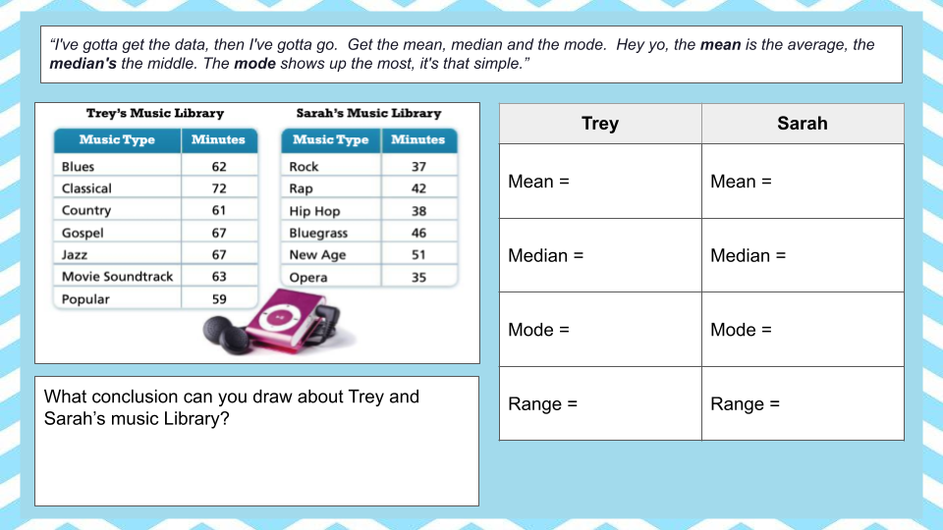
Type
Type
Type
Type
Type
Type
Type
Type
Type

Slide 4
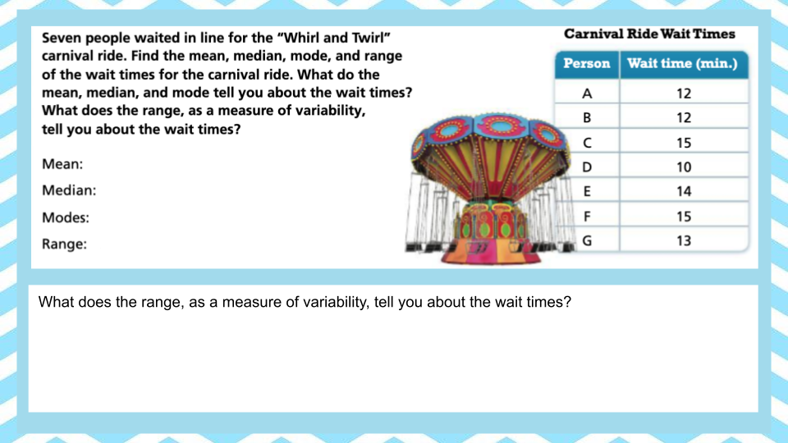
Type

Slide 5
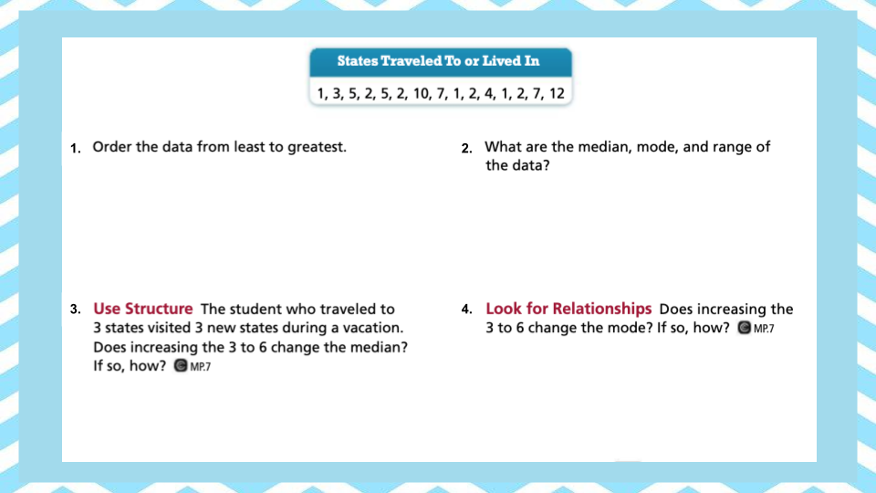
Type
Type
Type
Type

Slide 6
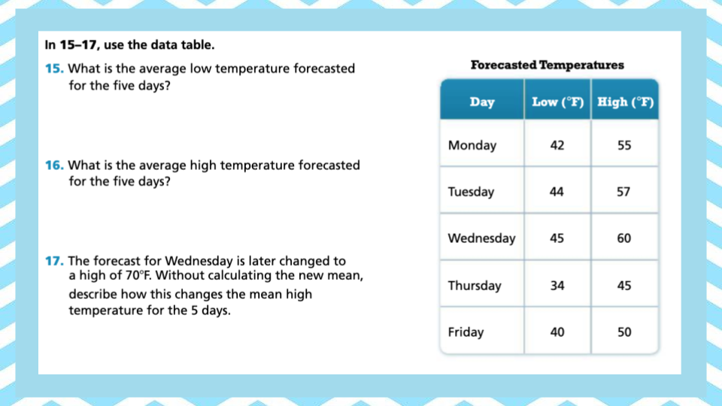
Type
Type
Type

Slide 7
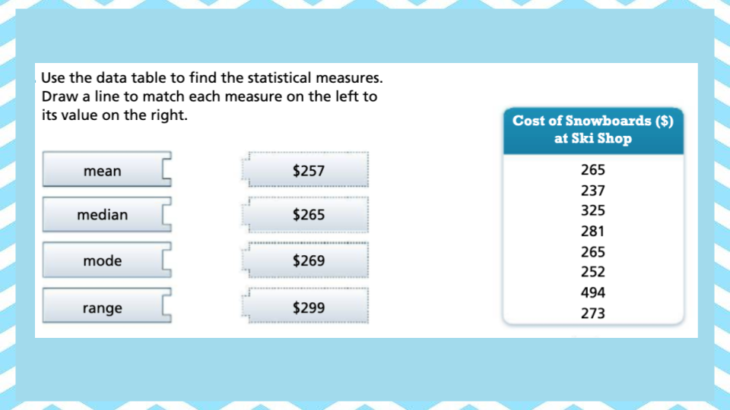

Slide 8
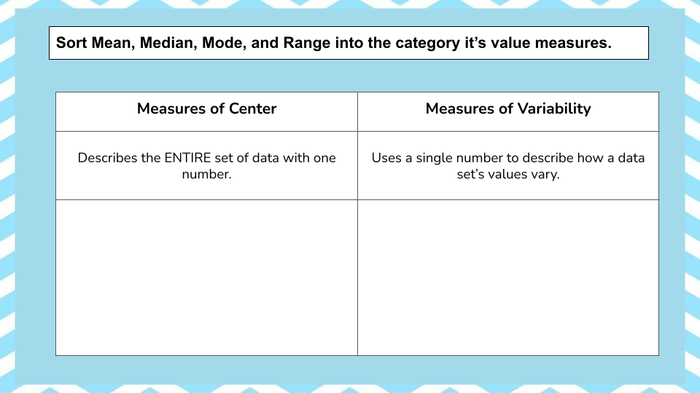
Range
Mode
Median
Mean

Slide 9

Still confused? Watch this video on Mean, Median, Mode, and Range.

