Slide 1
Desmos Geometry
Dia de los Muertos
Challenge

Slide 2
¡Hola!
Día de los Muertos, or the Day of the Dead, “originated several thousand years ago with the Aztec, Toltec, and other Nahua people, who considered mourning the dead disrespectful. For these pre-Hispanic cultures, death was a natural phase in life’s long continuum. The dead were still members of the community, kept alive in memory and spirit—and during Día de los Muertos, they temporarily returned to Earth. Today’s Día de los Muertos celebration is a mash-up of pre-Hispanic religious rites and Christian feasts. It takes place on November 1 and 2—All Saints’ Day and All Souls’ Day on the Catholic calendar—around the time of the fall maize harvest.
The centerpiece of the celebration is an altar, or ofrenda, built in private homes and cemeteries. These aren’t altars for worshipping; rather, they’re meant to welcome spirits back to the realm of the living. As such, they’re loaded with offerings—water to quench thirst after the long journey, food, family photos, and a candle for each dead relative.”
From https://www.nationalgeographic.com/travel/article/top-ten-day-of-dead-mexico

Slide 3
The Ofrenda Challenge
See how many “offerings” you can bring to the altar! For each challenge slide, follow these instructions. If you are able to complete each slide correctly, you will receive a special prize!
LEARN: Click on the Desmos icon on the slide to watch the instructional video. (Note: not all slides have a video.)
“Desmos-trate” your knowledge: Open the Desmos Geometry Tool at desmos.com/geometry. Sign in using your Google Single-Sign On.
Perform the task with the tool.
Take a screenshot or video of your work with the steps you tool. The title of each slide will tell you which one to use.
  Make sure to include your name in the screenshot.
  Make sure to demonstrate and explain each step to do the construction in your video.
Insert the screenshot onto the slide.
Repeat for each slide and then try the Challenge!

Slide 4
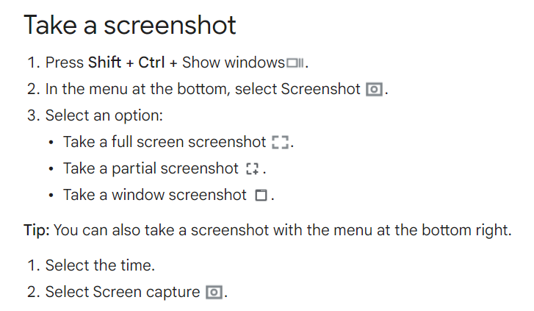
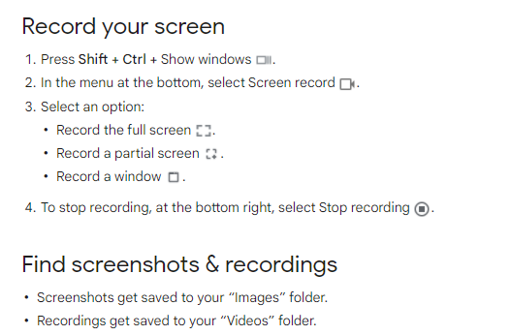
How to Take a Screenshot
How to Record
Your Screen
Click the Settings icon to turn on your microphone.
Make sure your name appears
in your screenshot.
After stopping recording, click on the dialogue box that appears in the bottom right hand corner. You need to drag your new video into your Google Drive.

Slide 5
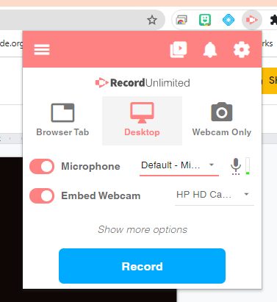

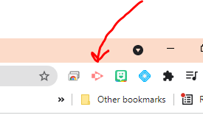
How to Take Video of Your Work using Screencastify
Step 2: Click on the icon and then choose Desktop. Make sure that your microphone and webcam are toggled on. Then click Record!
Step 1: Look for the Screencastify extension icon in the top right hand corner of your window.”:
Step 3: A dialog box will pop up and ask you which screen - click the screen shown. Then click Share at the bottom. Screencastify will count you down to start recording!
If it is not there, click on the puzzle piece and click the pin next to its name.
Notes:
OPTIONAL if you want students to use the Screencastify tool.

Slide 6
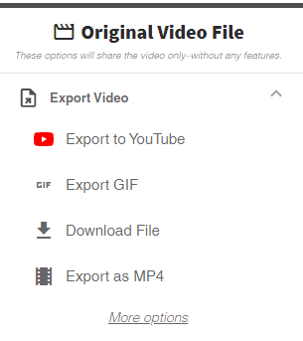
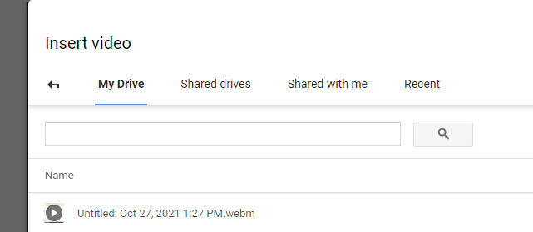
Posting Video in the Slide Deck
Step 2: A new tab will open with your video.
Choose Export as MP4 and insert into your slide with the Insert tab in Google Slides. Choose Video and then Google Drive to insert your video.
OR
Step 1: Hit Stop Share when you are finished.
If it is not there, click on the puzzle piece and click the pin next to its name.
Notes:
OPTIONAL if you want students to use the Screencastify tool.

Slide 7
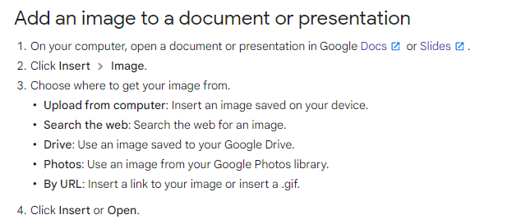
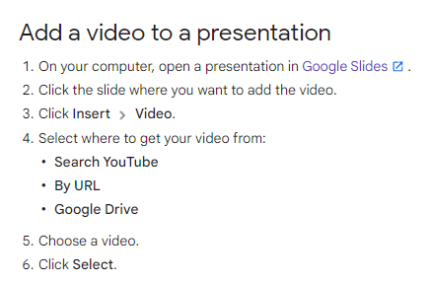
How to Insert Your Screenshot or Video into the Slide Deck
Choose Drive.
Choose Drive.

Slide 8
¡VAMOS!
Let’s start the challenge!

Slide 9

#1
Screenshot:
I can create three points and connect them with segments.
Video Instructions

Slide 10
#2
Video:
I can create a line, a ray, and a segment and label two points on each.

Slide 11
#3
Screenshot:
I can create a quadrilateral and label the vertices.
Video Instructions

Slide 12
Screenshot:
I can create a triangle and measure the side lengths.
#4
Video Instructions

Slide 13
#5
Video:
I can create three circles and change the color of each one.

Slide 14
#6
Video:
I can create a triangle, hide the vertices, and move the triangle around by dragging its sides.

Slide 15
Screenshot:
I can open this transformation, select all the objects, and change the angle of rotation.
I can save my new graph and copy the URL. Paste that link in the computer screen below.
#7
Paste your link here.

Slide 16
#8
Screenshot:
I can open the Pythagorean Theorem example graph and show the hidden objects.

Slide 17
#9
Screenshot:
Given a line segment, I can construct its midpoint.
Video Instructions

Slide 18
#10
Screenshot:
Given a line and any point on it, I can construct a perpendicular line through the given point.
Video Instructions

Slide 19
#11
Video:
Given a line and any point not on it, I can construct a parallel line through the given point.
Video Instructions

Slide 20
#12
Video:
Given a segment, I can construct a right triangle and measure its angles.
Video Instructions

Slide 21
#13
Screenshot:
Given two intersecting lines, I can create a circle centered at the point of intersection.

Slide 22
#14
Ofrenda Challenge:
Screenshot: I can use the transformation tools to create geometric art.
(Example 1, Example 2, Example 3)

Slide 23
Congratulations!
¡Feliz Día de Muertos!
What do you think about the Desmos Geometry Tool?
Which constructions were the most challenging? Would you like to use the Geometry Tool more often?
Answer here:

Slide 24
Make sure to upload this slide deck to Canvas or share with your teacher.

Slide 25
Credits
Special thanks to all the people who made and released these awesome resources for free:
Background illustrated by Alex Monge for SlidesCarnival
Presentation template by SlidesCarnival
Photographs by Unsplash

Slide 26

Free templates for all your presentation needs
For PowerPoint and Google Slides
100% free for personal or commercial use
Ready to use, professional and customizable
Blow your audience away with attractive visuals

