Slide 1
Getting to Know the
Kentucky Academic Standards for Career Studies and Financial Literacy
Module 1: Section 1A
Revision Process Overview

Slide 2
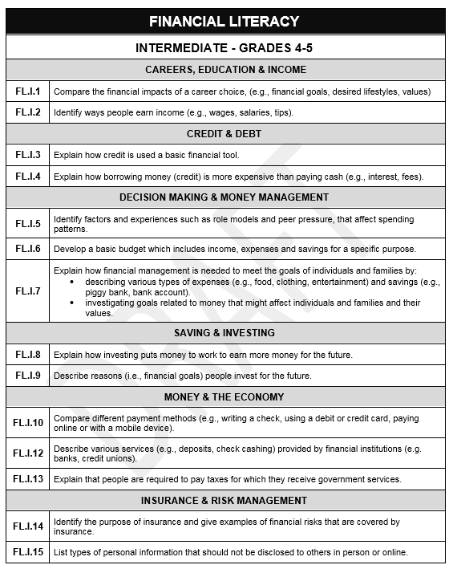
Committee Roles
DOMAIN
Business & Education Advisory Panel (BE) determined the framework that included:
  critical domains
  corresponding strands
Revision & Writing Committee (RWC) used the guidance from the BE panel to create the standards
STRAND
STANDARD

Slide 3
Writer’s Vision
All students will graduate from high school with the knowledge and skills needed to become successful lifelong learners and productively engaged citizens. To achieve this, the team envisioned standards that:
allow for integration of career exploration across content areas;
enhance the learning of academic subjects;
foster development of skills essential to the workplace;
consider the role of personal values, interests and aptitudes in career choices; and,
support students’ ability to manage personal and workplace resources including time, materials and finances.

Slide 4
Scope of the Standards
Although not a tested area, KRS 156:160 requires school districts to ensure student access to standards through programs, services and operational performance.
Student access may be ensured through:
  aligned integration into other content areas
  intentionally designed enrichment programs and/or experiences
  Stand-alone courses
Should support and guide development of a students’ Individual Learning Plan (ILP)
Notes:
KRS 156.160 Promulgation of administrative regulations by the Kentucky Board of Education
With the advice of the Local Superintendents Advisory Council (LSAC), the KBE shall promulgate administrative regulations establishing standards that public-school districts shall meet in student, program, service and operational performance. These regulations shall comply with the expected outcomes for students and schools set forth in KRS 158:6451.

Slide 5
The KAS for Career Studies are…
goals or outcome of an education program.
statements of what students should be able to do after instruction.
The KAS for Career Studies are NOT…
a set of instructional or assessment tasks.

Slide 6
The KAS for Career Studies do…
establish what students should know and be able to do at the conclusion of a grade-band.
The KAS for Career Studies do NOT…
dictate curriculum or teaching methods.
dictate the design of a lesson or how units should be organized.

Slide 7
Coming Up
Section 1B: Understanding the Architecture
Section 1C: Understanding the Domains and Strands

Slide 8
Understanding the Architecture
Essential Questions
How are the standards organized?

Slide 9

Grade-Band Progressions
Arranged by grade-bands:
  Primary – K-3
  Intermediate – 4-5
  Middle School – 6-8
  High School – 9-12
Describe what students should know and be able to do at the end of each grade-band.

Slide 10
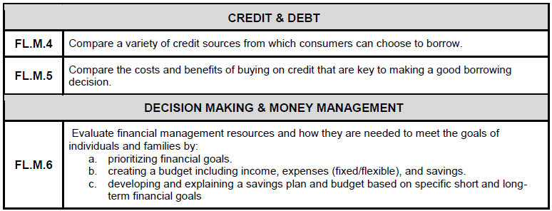
Standards Coding
F L . M . 4
DOMAIN
GRADE BAND
STANDARD NUMBER
Some standards may include a substandard that would be denoted by an additional letter.
F L . M . 6a
SUBSTANDARD
Notes:
Note: Strands are not denoted in the standard coding.

Slide 11
Domains
Essential Skills
  Replaces Employability domain
  KRS 158.1413 Essential Workplace Ethics Instruction
  Includes Communication (Speaking & Listening)
Careers
Financial Literacy
  Combines Consumer Decisions and Financial Literary
  KRS 158.1411 Financial Literacy high school graduation requirement
  9-12 grade band was developed by separate committees
Notes:
Note: The Essential Skills and Financial Literacy domains were written to align with the statutes listed above.
The Essential Skills domain includes Communication - Speaking & Listening standards. These were removed from the revised Reading & Writing standards.
KRS 158.1413 Essential Workplace Ethics Instruction
Beginning with the 2019-2020 school year, each school district shall implement essential workplace ethics programs that promote characteristics that are critical to success in the workplace.
KRS 158.1411 Financial Literacy
Beginning with the entering ninth grade class of the 2020-2021 school year and each year thereafter, successful completion of one (1) or more courses or programs that meet the financial literacy standards shall be a Kentucky public high school graduation requirement.

Slide 12
Financial Literacy Strands
Strands include:
  Careers, Education & Income
  Credit & Debt
  Decision Making & Money Management
  Saving & Investing
  Money & The Economy
  Insurance & Risk Management
9-12 grade- band meets KRS 158.1411 Financial Literacy high school graduation requirement

Slide 13
Financial Literacy Guidelines
Effective Financial Literacy (FL) instruction is a critical component of transition readiness and should be:
Focused on the standards
Relevant
Learner-centered
Connected to the real-world
Integrated with other curricular areas
Community-focused

