Slide 1
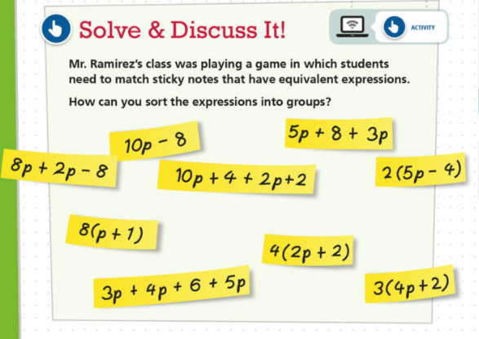
Notes:
🍐 This is a Pear Deck Drawing Slide
🍐 To edit the type of question, go back to the "Ask Students a Question" in the Pear Deck sidebar.

Slide 2
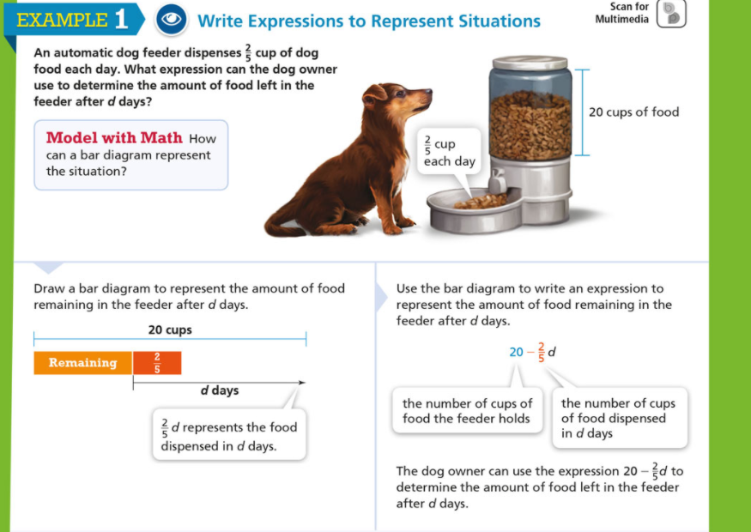
Notes:
🍐 This is a Pear Deck Drawing Slide
🍐 To edit the type of question, go back to the "Ask Students a Question" in the Pear Deck sidebar.

Slide 3
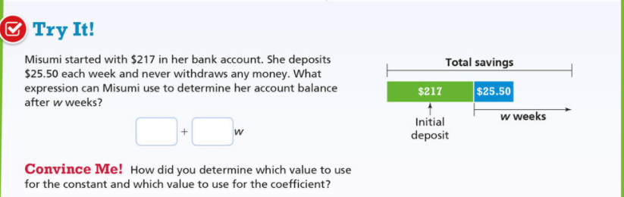
Fill in the blanks the the correct value and then explain your choice below
Notes:
🍐 This is a Pear Deck Drawing Slide
🍐 To edit the type of question, go back to the "Ask Students a Question" in the Pear Deck sidebar.

Slide 4
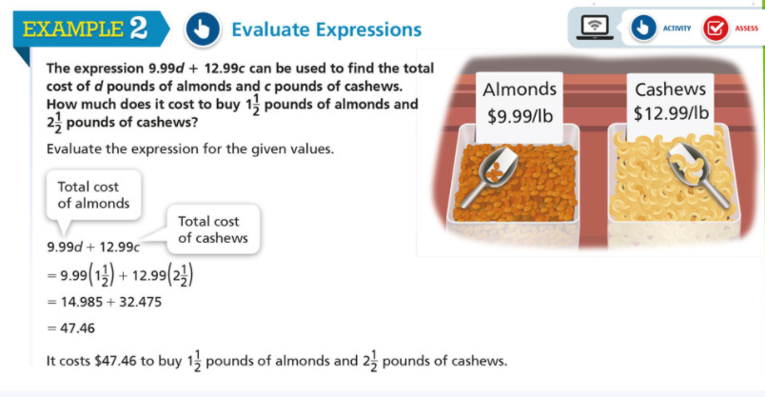
Notes:
🍐 This is a Pear Deck Drawing Slide
🍐 To edit the type of question, go back to the "Ask Students a Question" in the Pear Deck sidebar.

Slide 5
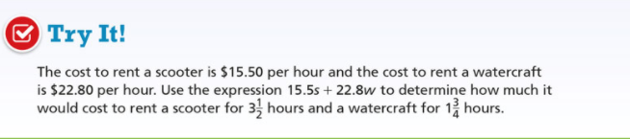
Notes:
🍐 This is a Pear Deck Drawing Slide
🍐 To edit the type of question, go back to the "Ask Students a Question" in the Pear Deck sidebar.

Slide 6
Brain Break Time
Notes:
🍐 This is a Pear Deck Drawing Slide
🍐 To edit the type of question, go back to the "Ask Students a Question" in the Pear Deck sidebar.

Slide 7
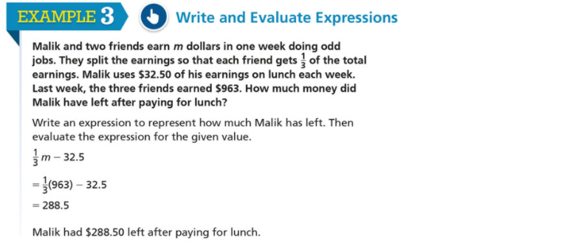
Notes:
🍐 This is a Pear Deck Drawing Slide
🍐 To edit the type of question, go back to the "Ask Students a Question" in the Pear Deck sidebar.

Slide 8
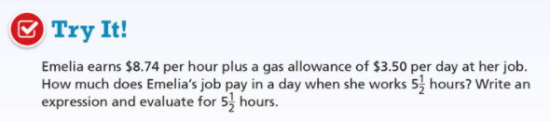
Write the expression
Find the answer if Emelia works 5 ½ hours.
Notes:
🍐 This is a Pear Deck Drawing Slide
🍐 To edit the type of question, go back to the "Ask Students a Question" in the Pear Deck sidebar.

Slide 9
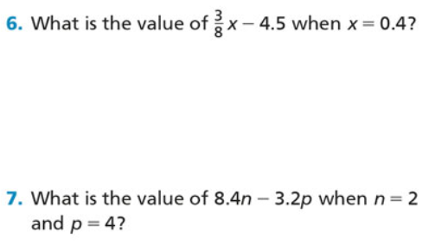
Notes:
🍐 This is a Pear Deck Drawing Slide
🍐 To edit the type of question, go back to the "Ask Students a Question" in the Pear Deck sidebar.

Slide 10
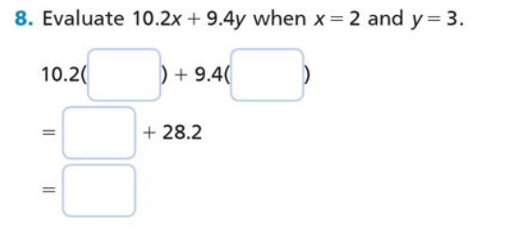
Fill in the blanks the correct numbers
Notes:
🍐 This is a Pear Deck Drawing Slide
🍐 To edit the type of question, go back to the "Ask Students a Question" in the Pear Deck sidebar.

Slide 11
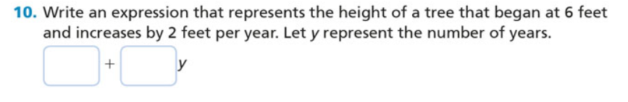
Fill in the blanks the correct numbers
Notes:
🍐 This is a Pear Deck Drawing Slide
🍐 To edit the type of question, go back to the "Ask Students a Question" in the Pear Deck sidebar.

Slide 12
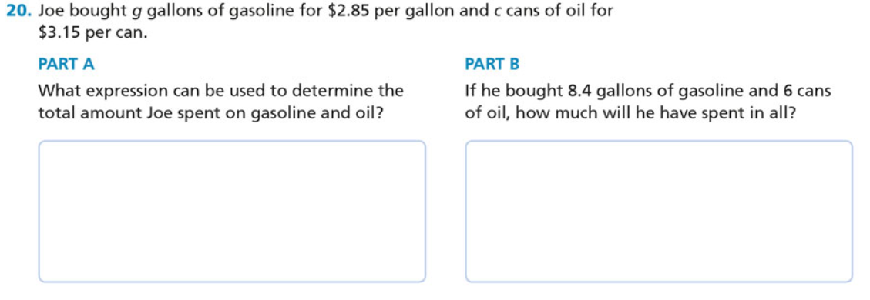
Fill in the blanks the correct numbers or expression
Notes:
🍐 This is a Pear Deck Drawing Slide
🍐 To edit the type of question, go back to the "Ask Students a Question" in the Pear Deck sidebar.

