Slide 1

Algebra 1 Release Day
Lesson 8-2 and 8-3
Vertex Form of a Quadratic Equation and
Quadratic Functions in Standard Form

Slide 2
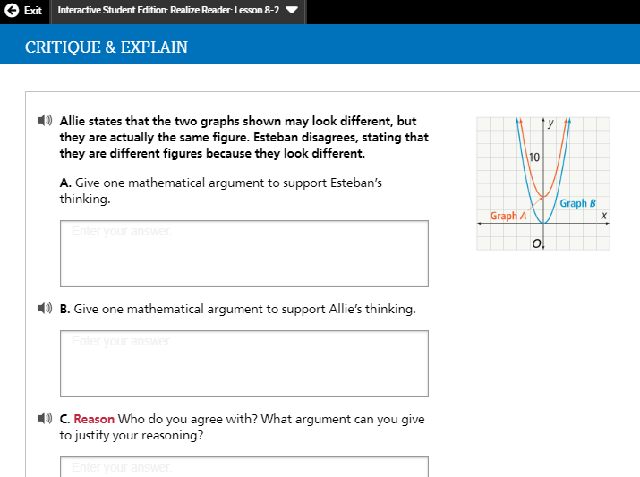

Slide 3
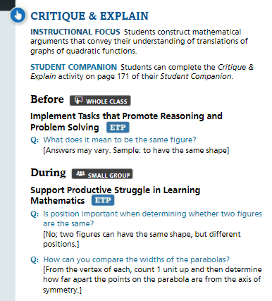
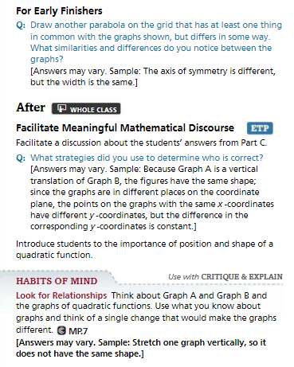

Slide 4
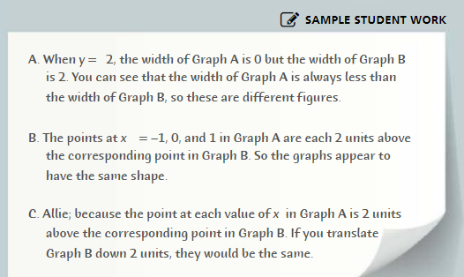

Slide 5
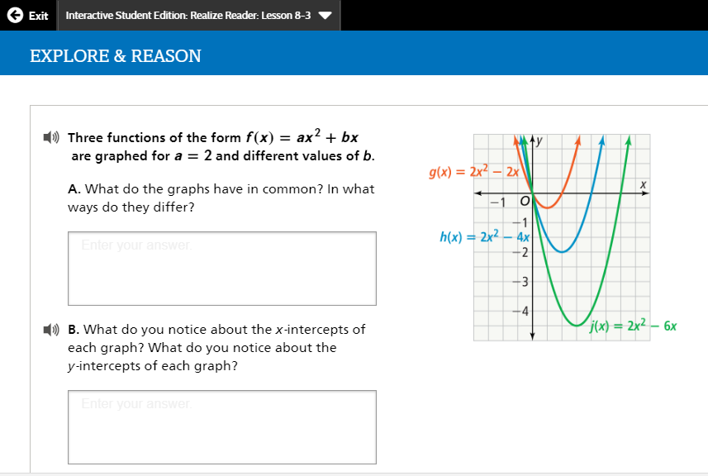
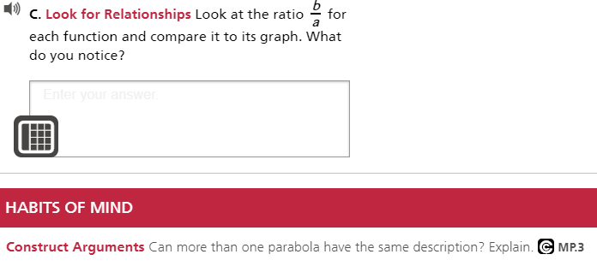

Slide 6
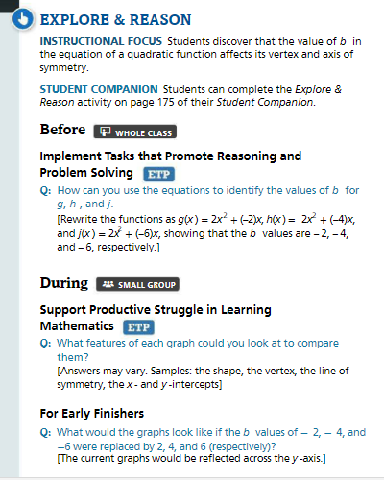
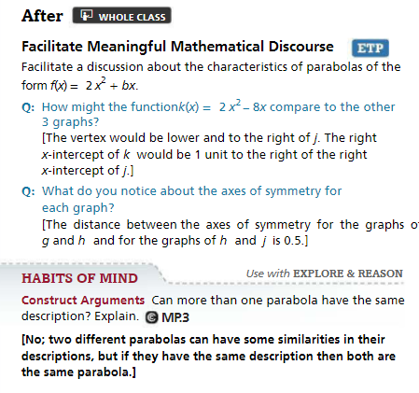

Slide 7
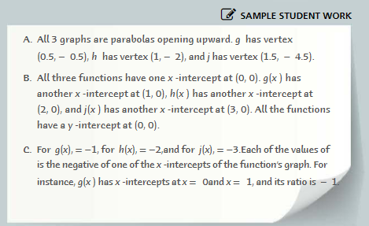

Slide 8


Let’s play commit and toss.
Write your answer and show your work on a post-it, do NOT write your name.

Slide 9

Quiz, Quiz Trade, or Showdown Cards
Lesson 8-2

Slide 10
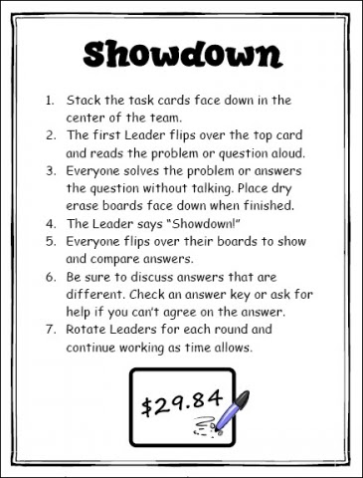
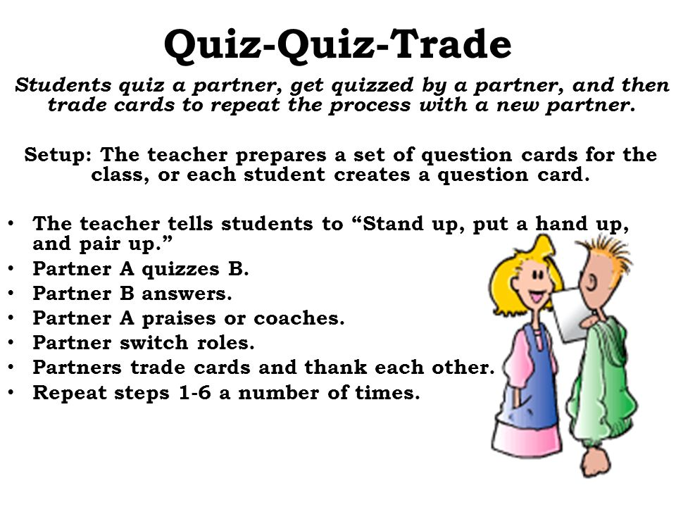

Slide 11
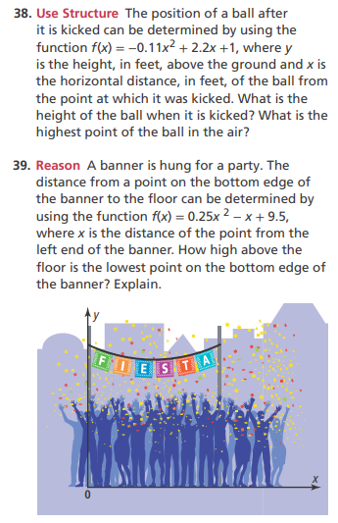
Numbered Heads Together, or Think, Pair, Share
Lesson 8-3

Slide 12
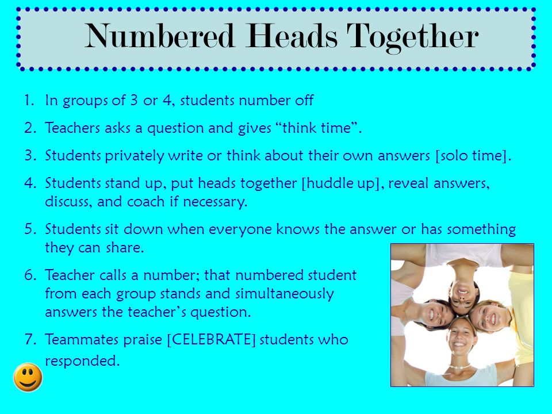
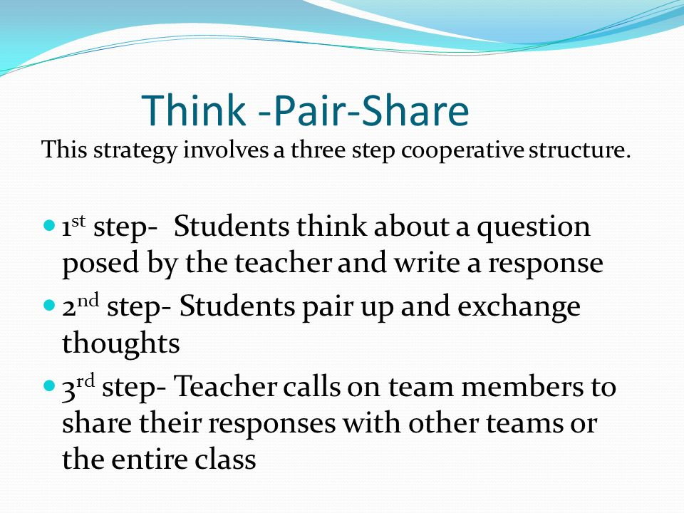

Slide 13
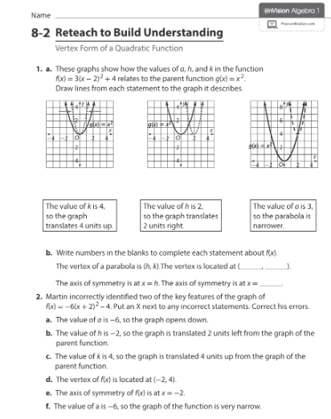
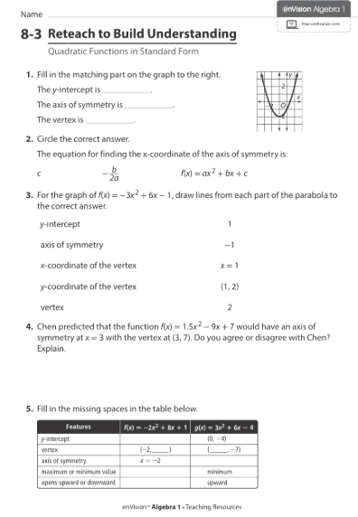

Slide 14


