Slide 1
To access a copy of this presentation:
bit.ly/mathspeeddating

Slide 2
The Set-Up
This activity is inside-outside circle with a twist.
Set desks facing each other, in a circle. (See next slide)
Calculator on every table
Number every table
Be ready to hand every student a card on the way in that tells them what table to sit at and has a problem to work. (I color-code Easy-Medium-Difficult problems, so that students can be successful with their Mastercard. Students don’t realize I am differentiating when I just hand them a different color.)
Have a timer ready to go for each “date” I do not time the first date, but do all others. Time depends on subject and how difficult but no more than 5 minutes usually.

Slide 3
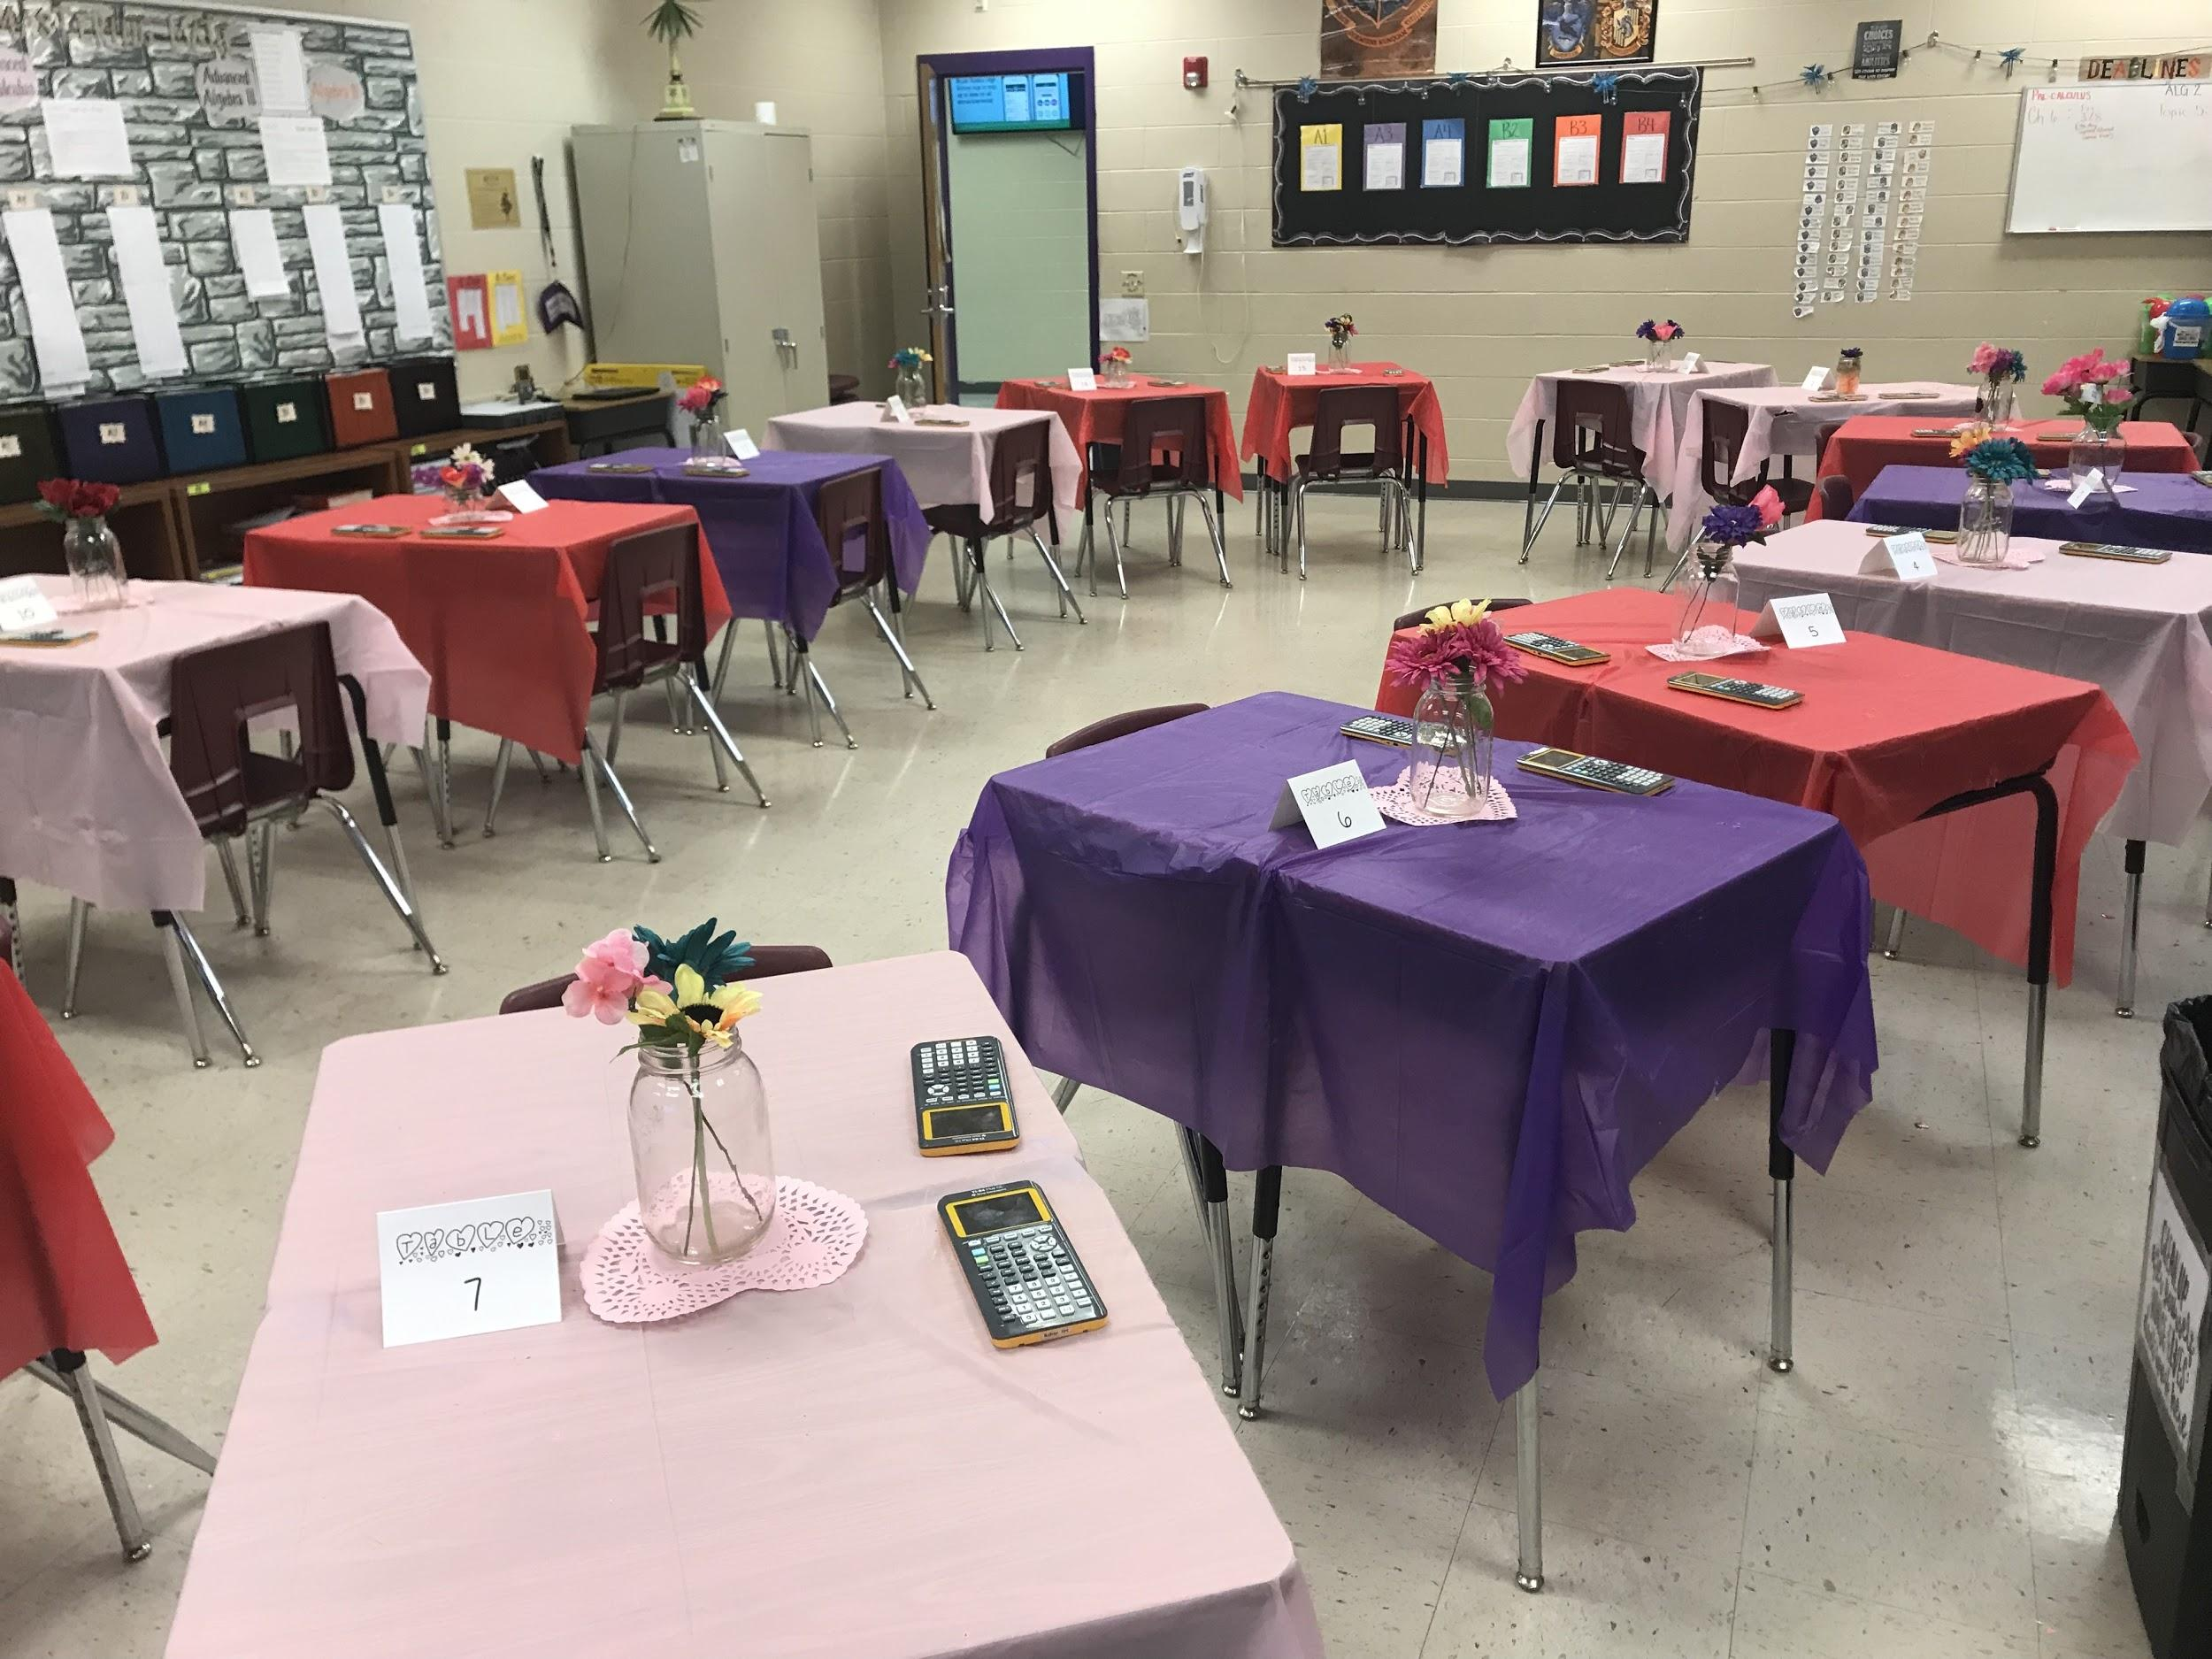

Slide 4
The “EXTRA” that isn’t necessary but adds flair...
Dollar Tree tablecloths, doilies, and flowers in a mason jar.
“Cute” cards.
At the start of every date I tell them to introduce themselves to their date and then an about me.
  “Introduce yourself and tell your date your favorite type of ice cream.”

Slide 5
Welcome to SPEED DATING
You were handed your mastercard. Work with your current date to MASTER that card. (You will be responsible for helping future dates)
Once ALL answers have been checked, I will tell you who is moving and which way.
Take your pencil, paper, and mastercard to each table with you
I have this slide on the board when they come in.
After the first date, I move to the next slide.

Slide 6
Expectations
Are you being dependable?
Are you communicating well?
Are you keeping your technology away?
You will work your date’s mastercard
You will ask them questions if you get stuck.
Your date will do the same.
Check each others answers to make sure you each know what you are doing
Non-math conversations only happen if extra time occurs.
^This is our eOS system (emplyability for PBIS)

Slide 7
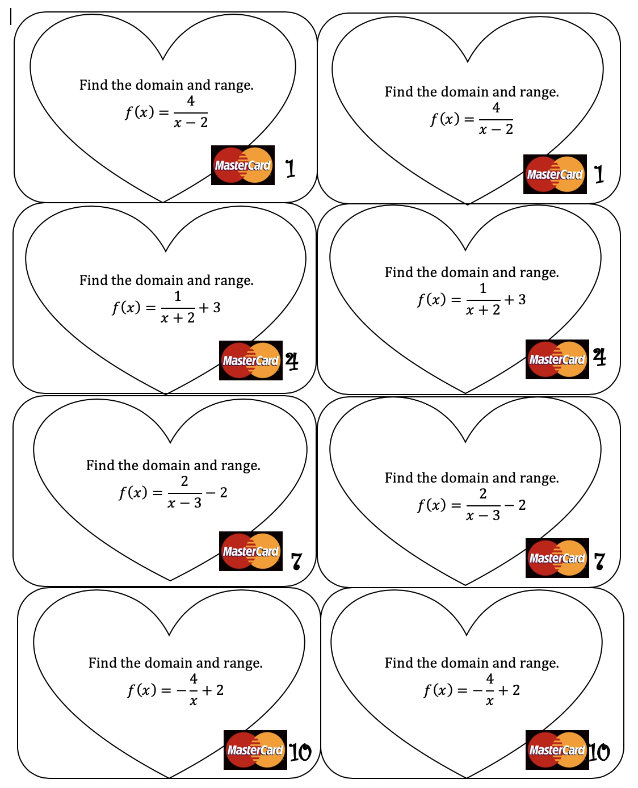
Link to document
*This was last year when we had just started Topic 4. I was not here to do speed dating this year, and plan to make it up to them soon.

Slide 8
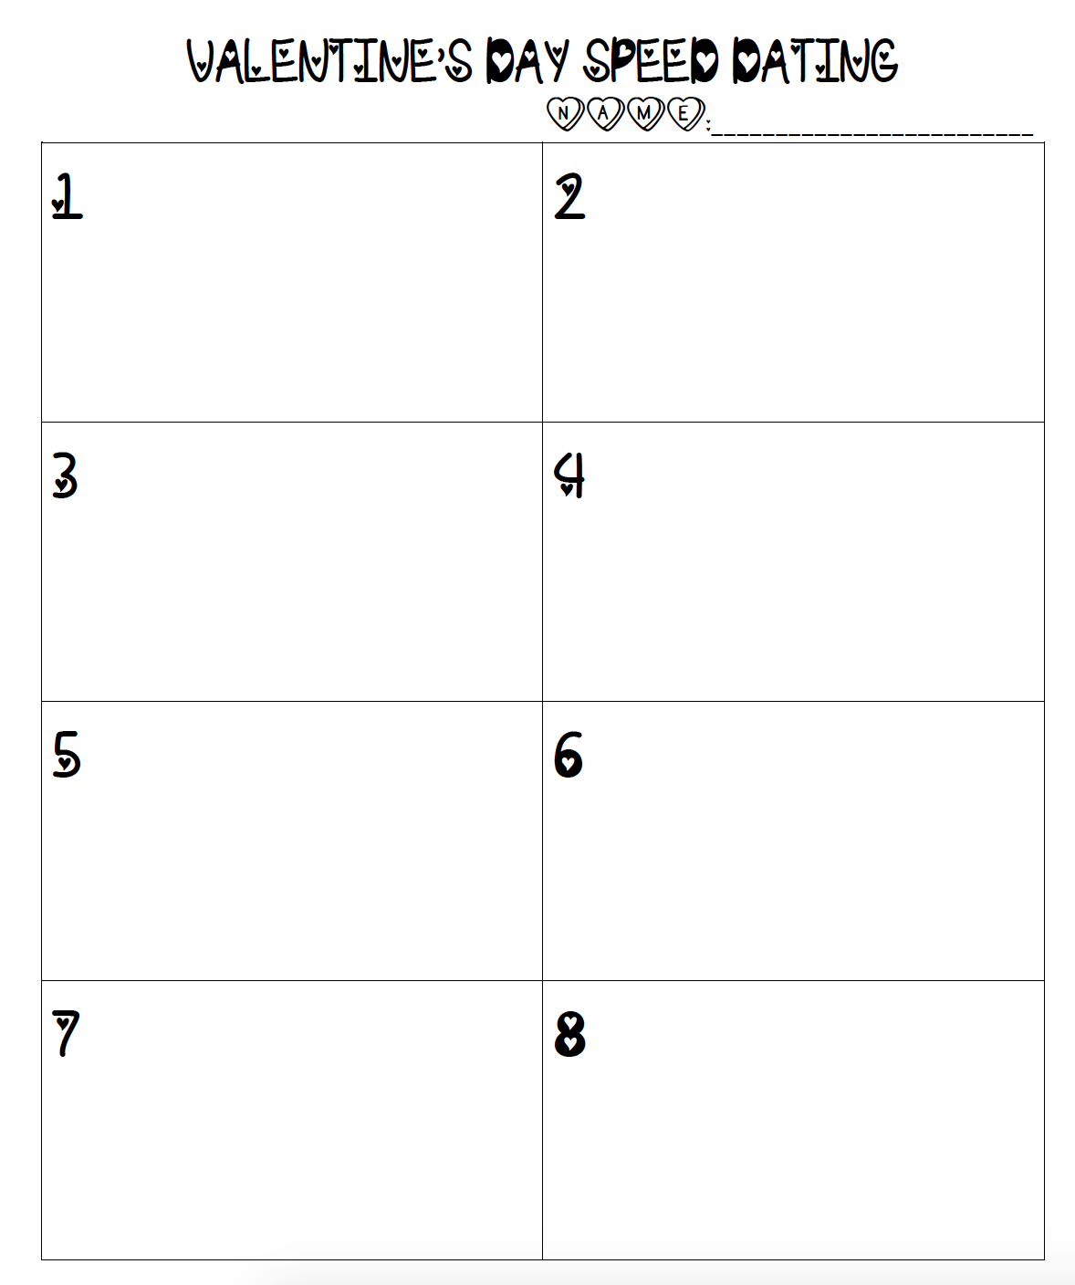
Link to worksheet

Slide 9
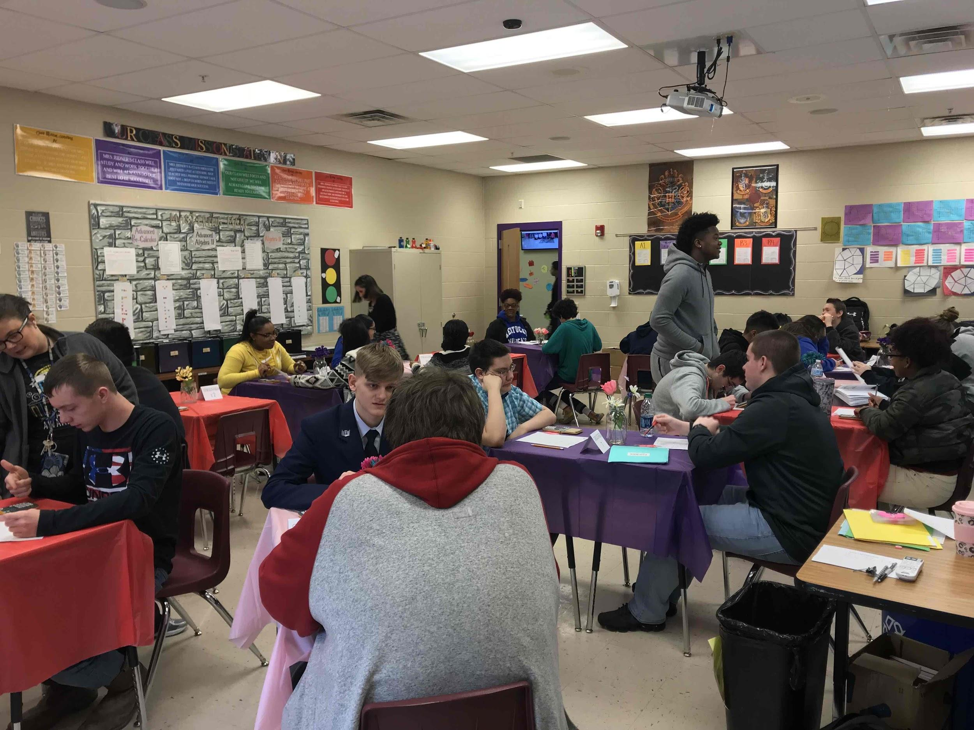
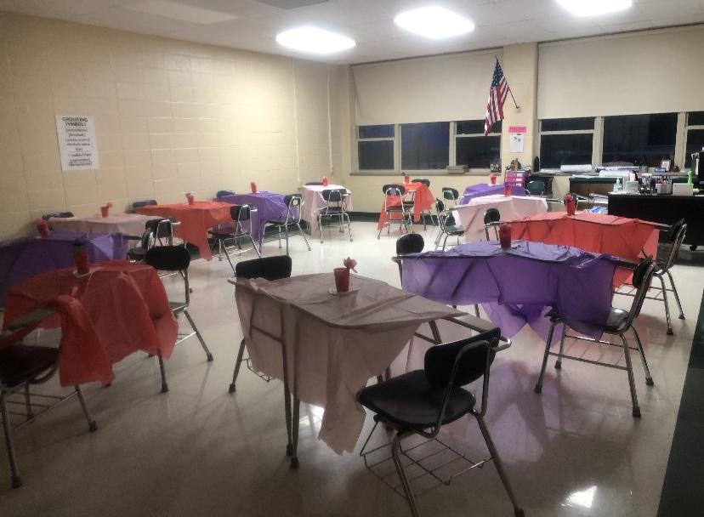
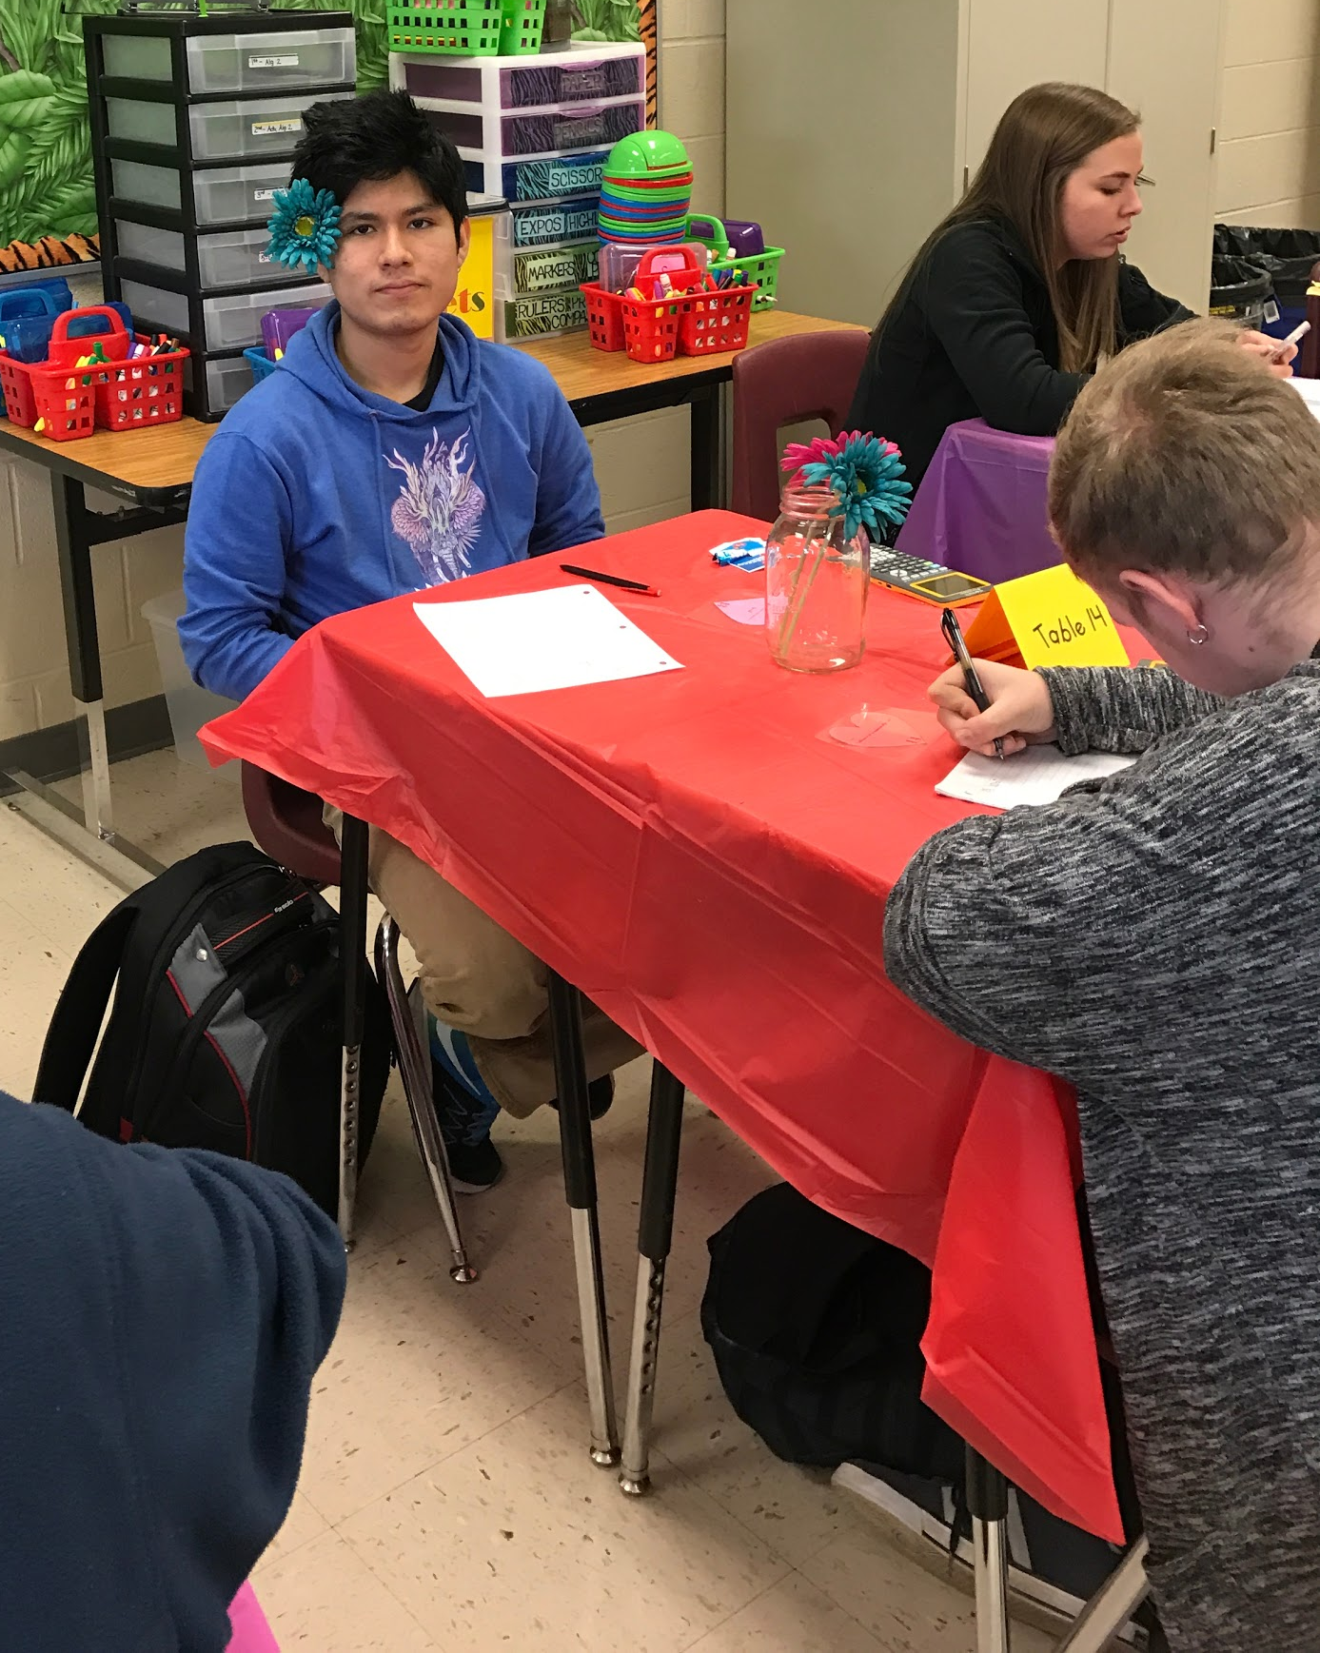
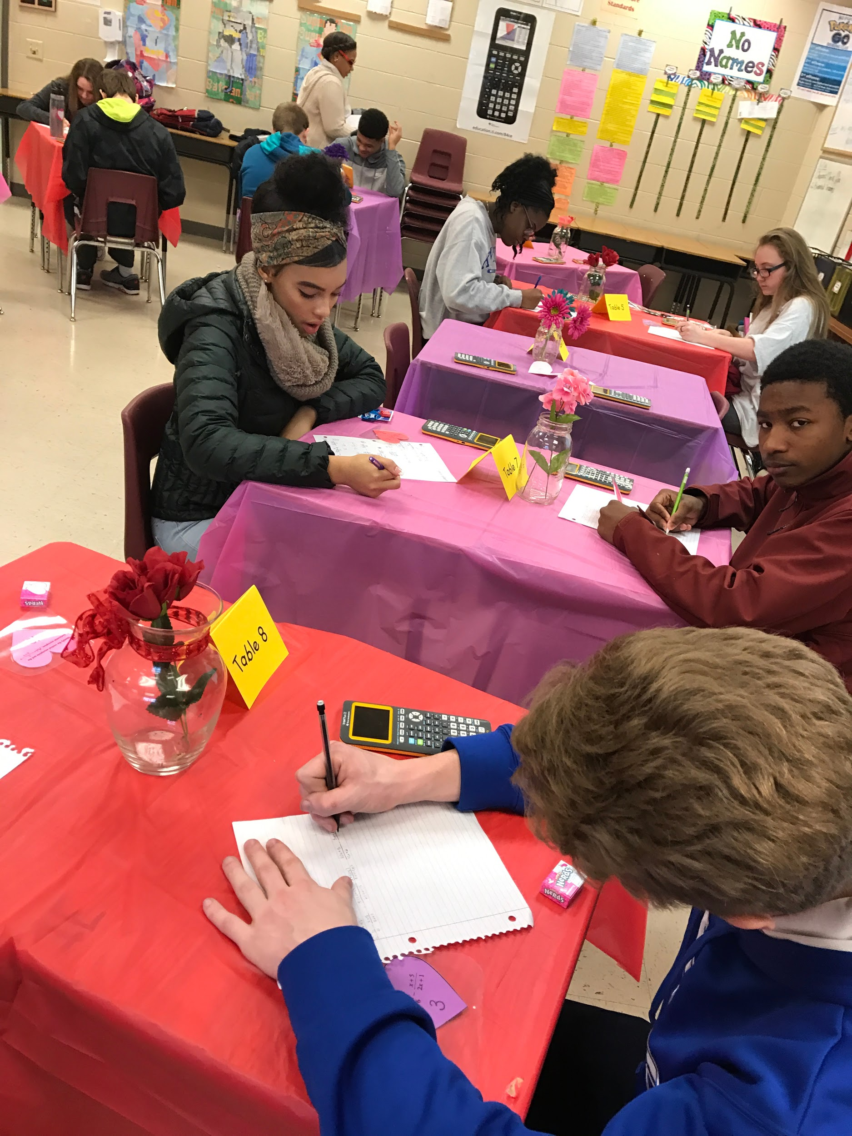
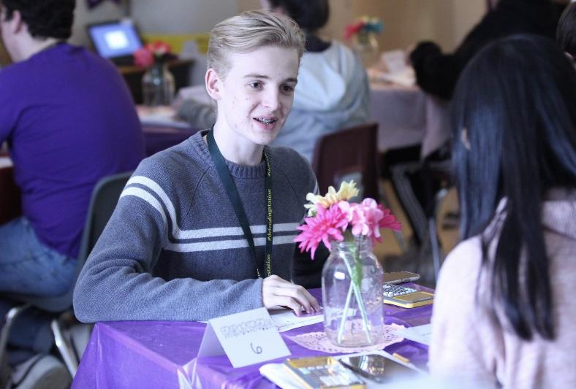
Student teacher from last year, with her own classroom this year!
I do this for all classes, all day, the day of Valentine’s Day and either the day before or after. (Adv. Alg. 2, Gen. Alg 2, Collab Alg 2, and Precalculus)
I usually give some sort of learning target at the end of the class, because after about 45- 1 hour, they are over it.

