Slide 1
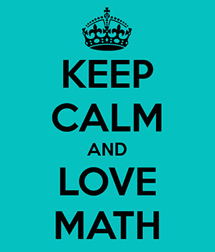

6th grade enVision
Lesson 3-3 Write and Evaluate Numerical Expressions

Slide 2
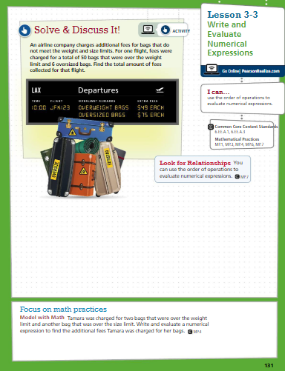
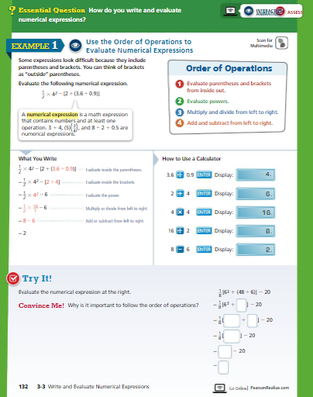

Slide 3
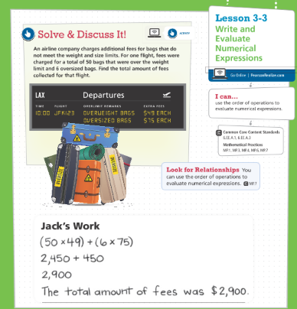
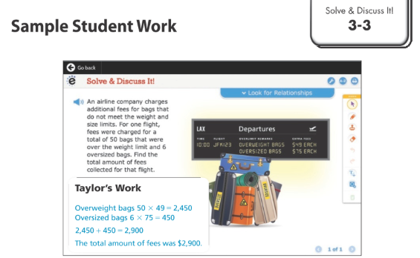
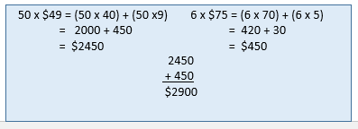
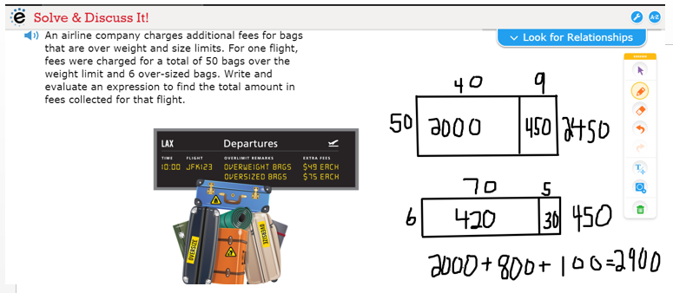

Slide 4
Choose the expression that is equal to 28.3.
Let’s play commit and toss.
Write your answer and show your work on a post-it, do NOT write your name.
A. 3³ + 27.2 – 6.8 + 2⁴ – 3.1
B. 3³ + 27.2 – (6.8 + 2⁴ – 3.1)
C. [3³ + (27.2 – 6.8)] + 2⁴ – 3.1
D. 3³ + 27.2 – (6.8 + 2⁴) – 3.1

Slide 5
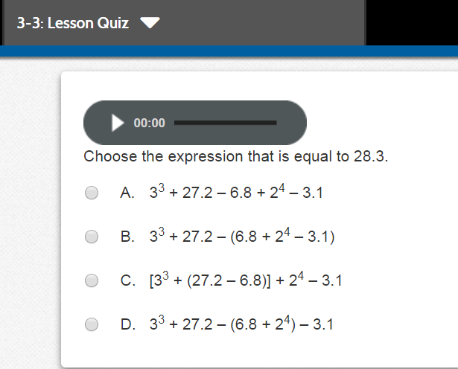

Slide 6
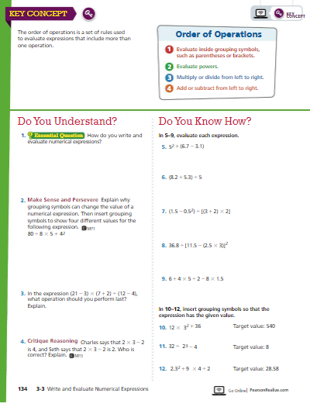
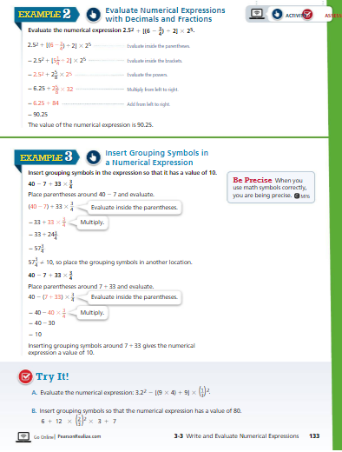

Slide 7
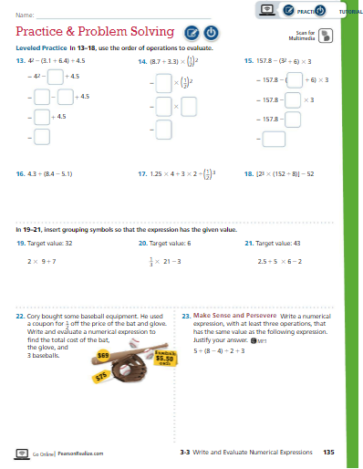
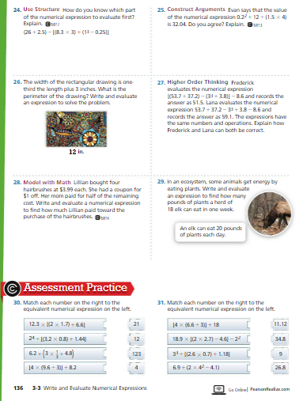
Which problems do you assign? How do you assign them?

Slide 8
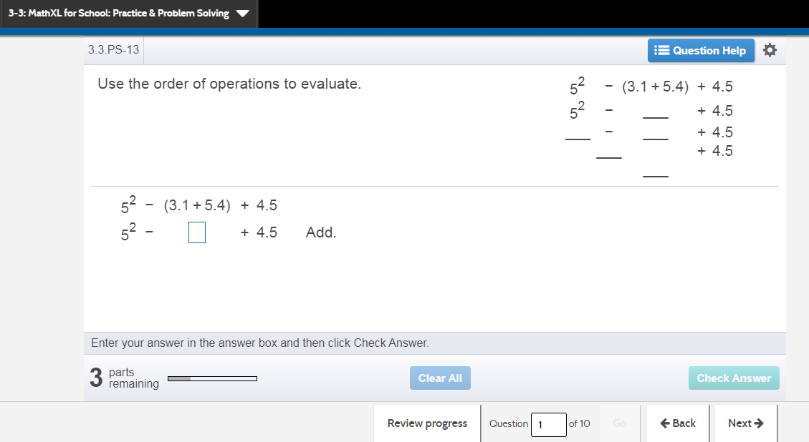

Slide 9
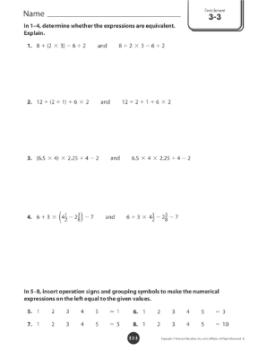
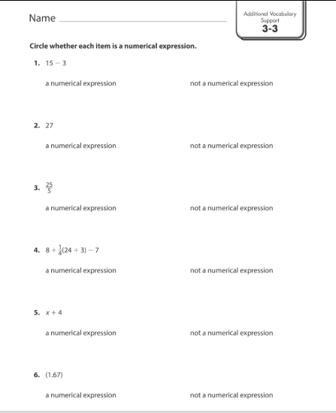

Slide 10
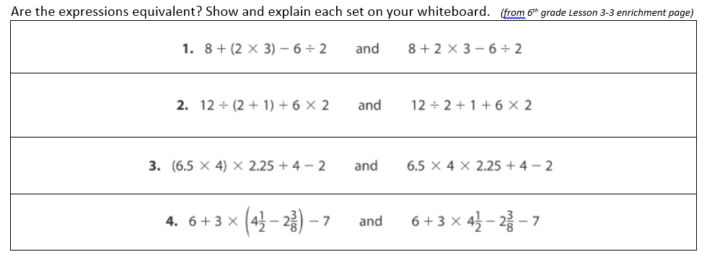
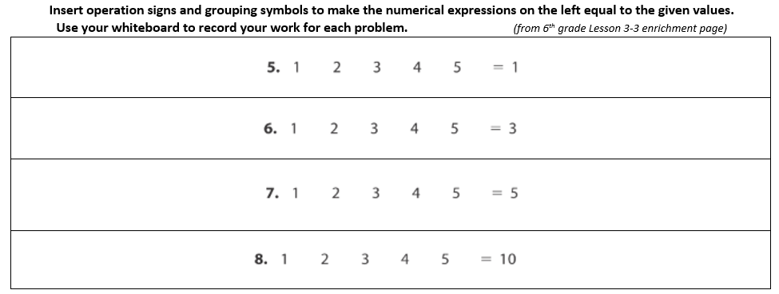
green
blue

Slide 11
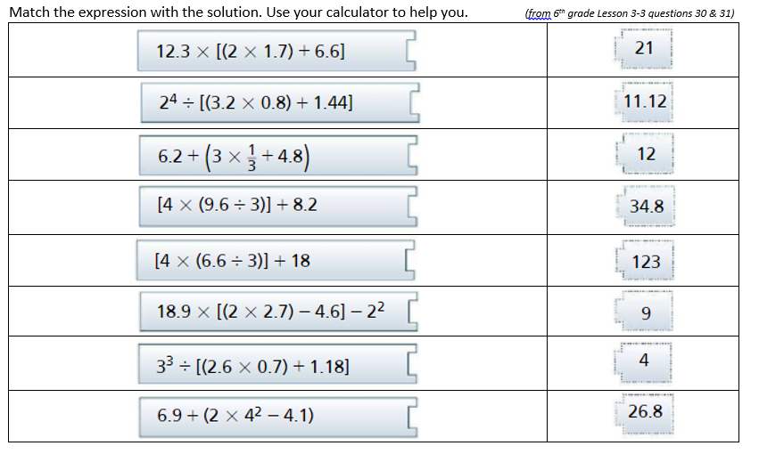
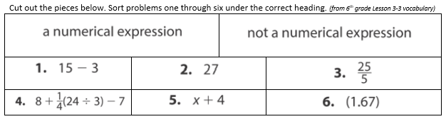
yellow
red

Slide 12
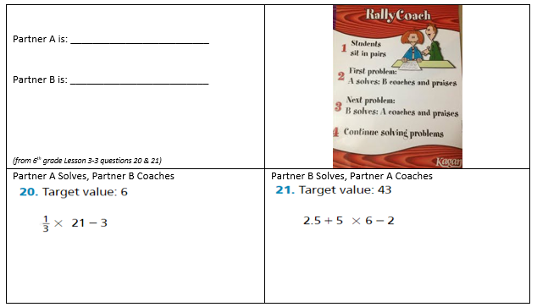
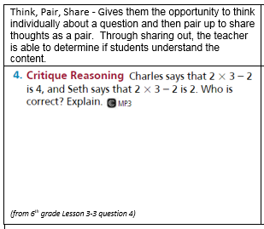
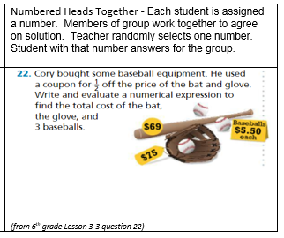
gray
salmon
salmon

Slide 13
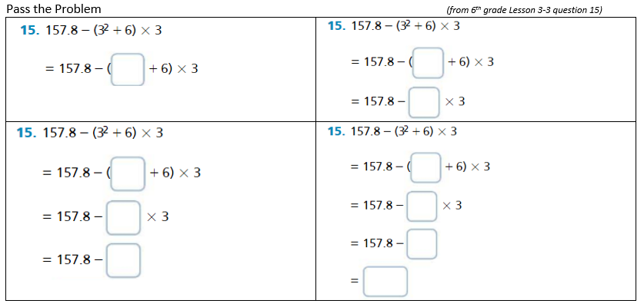

Slide 14


