Slide 1


Algebra I enVision
Lesson 4-2 Solving Systems of Equations with Substitution

Slide 2
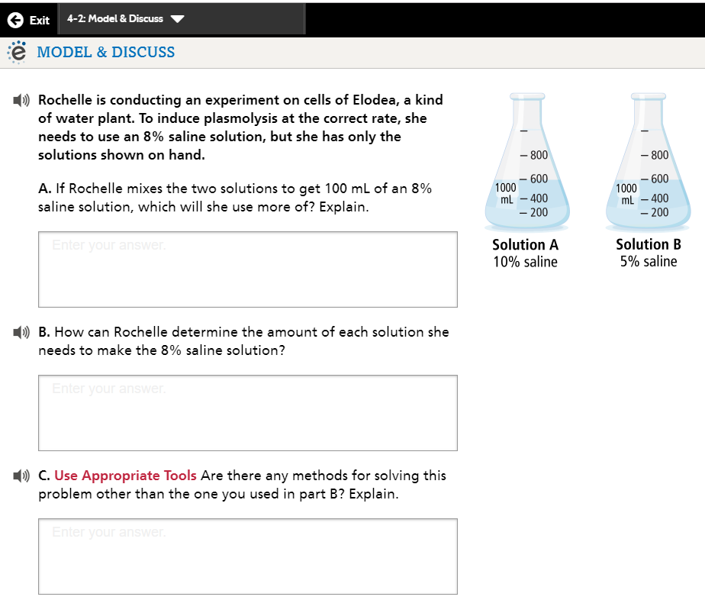
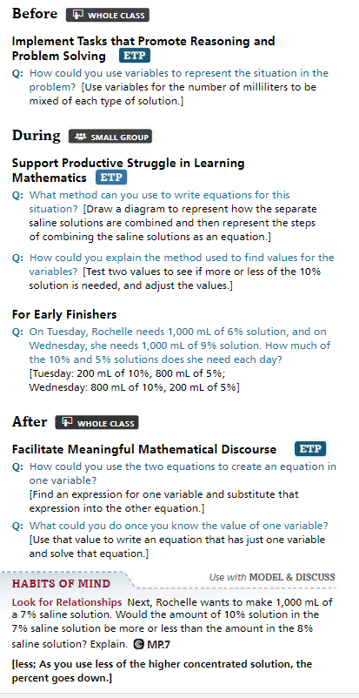

Slide 3
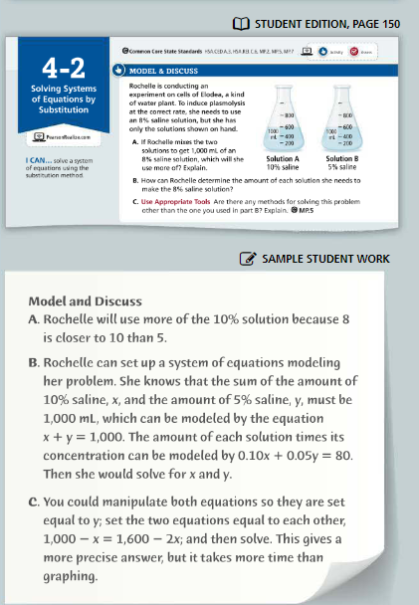
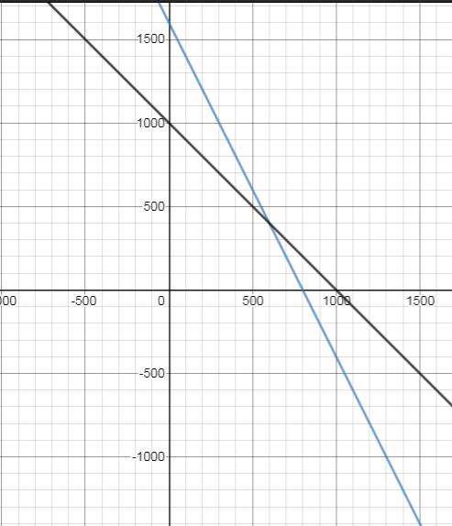
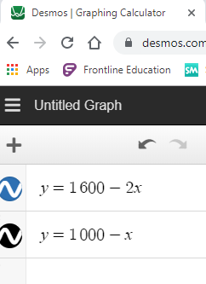
x + y = 1000
.10x + .05y = 80
Y=1000-x
.1x +.05(1000-x)=80
.1x +50-.05x=80
.05x=30
x=600
Y=400
.10(600) +.05(400)=80
60 +20=80
x + y = 1000
.10x + .05y = 80
Y=1000-x
.05y=80-.10x
Y=1600-2x
1000-x=1600-2x
1000+x=1600
X=600
Y=400
.10x
X=600
.05y
Y=400
60
20

Slide 4
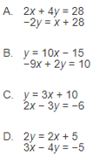
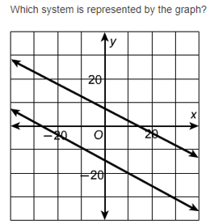
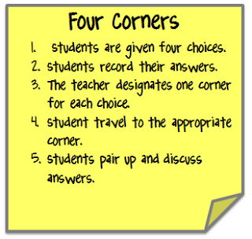
Let’s play commit and toss.
Write your answer and show your work on a post-it, do NOT write your name.

Slide 5
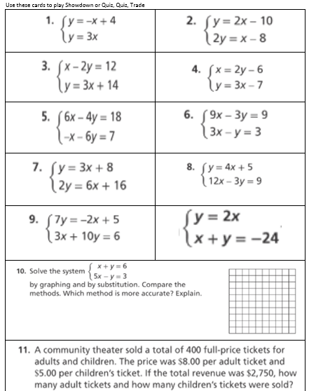
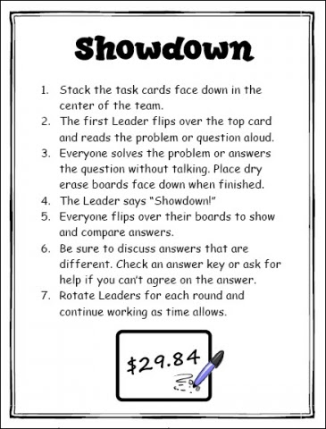
salmon

Slide 6


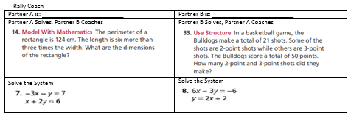
gray

Slide 7
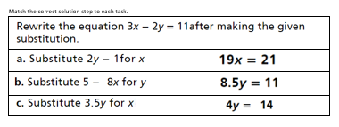
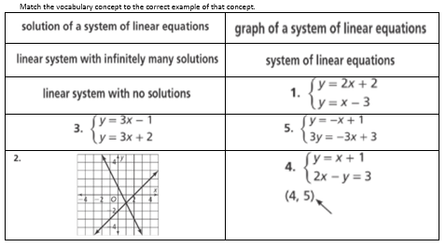
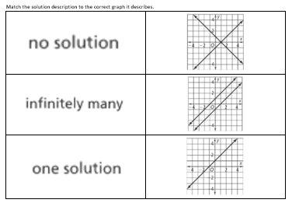
green
yellow
red

Slide 8
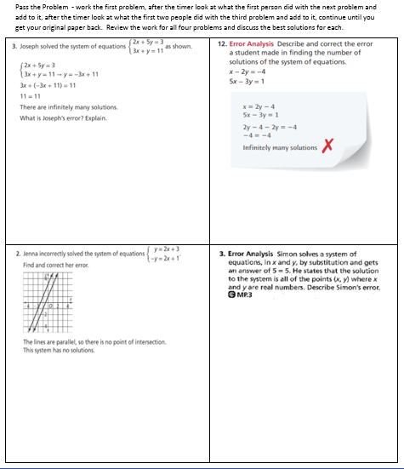
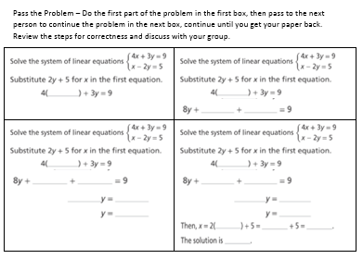
gray
blue

Slide 9
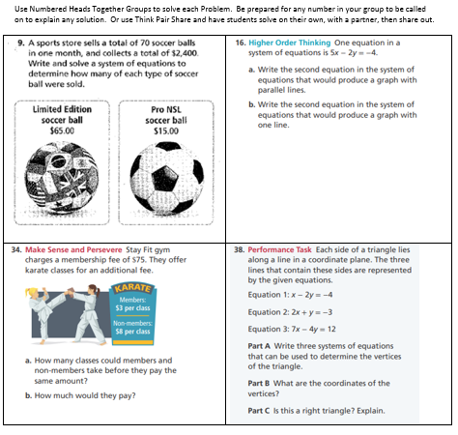

gray

Slide 10
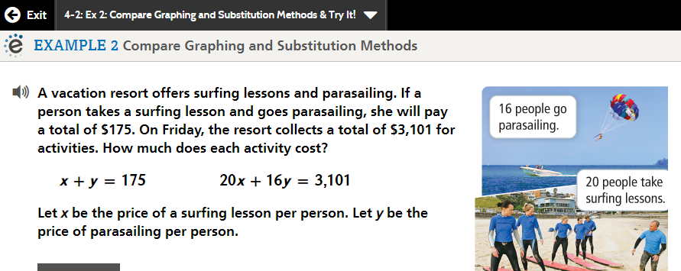
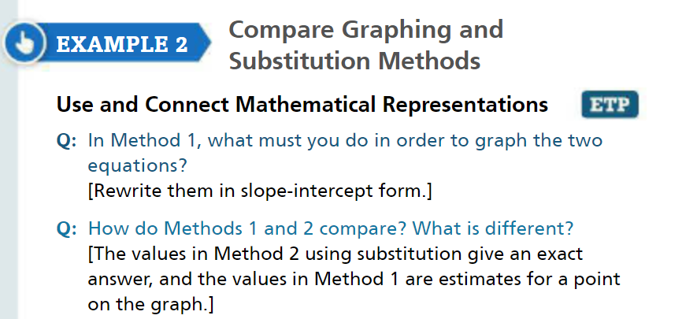
What cooperative structure/
engagement strategy could
use on the examples?

Slide 11
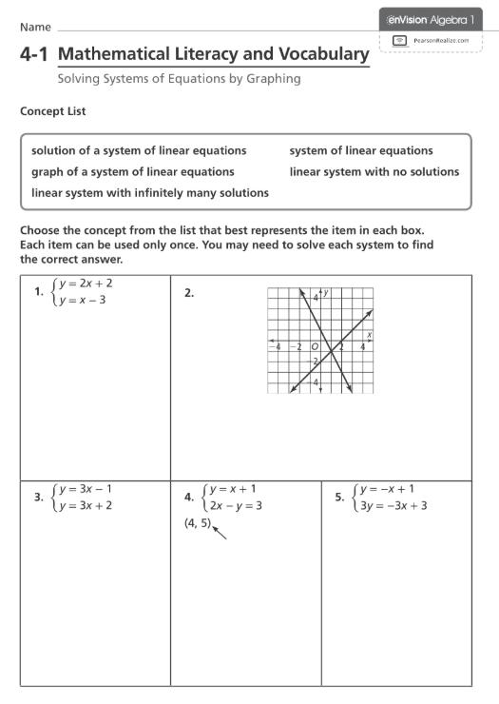
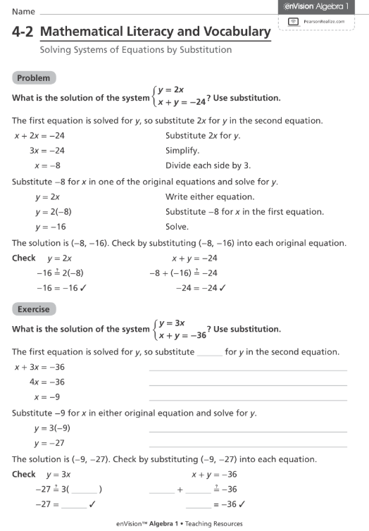

Slide 12
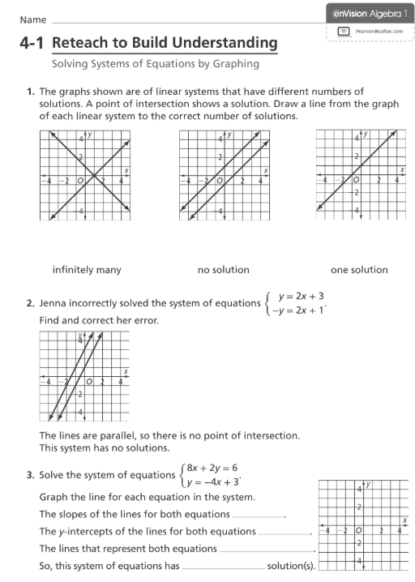
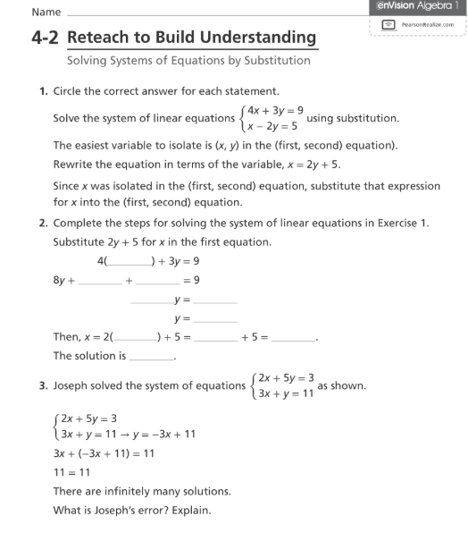

Slide 13
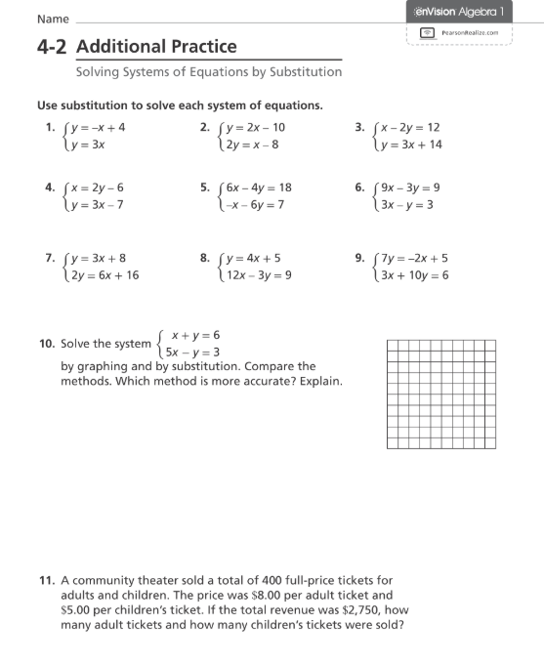
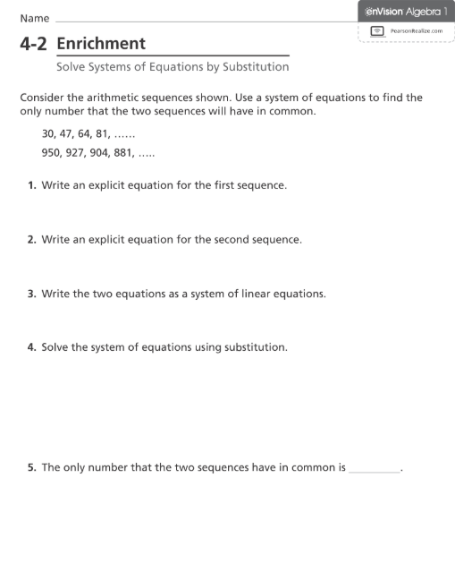

Slide 15


