Slide 1

Work through each task by reading carefully and filling in all boxes highlighted in yellow. You will also be required to use Desmos for graphing. You may work with a partner, but you must turn in your own work. Good luck!
Name:

Slide 2
The Outbreak Part 1- Situation 1
There are 500,000 people in your town. On the first night of the outbreak, 3 zombies enter your town and infect 3 people. Each night following, 3 more people are infected.
Night | 1
Total # Zombies | 6

Slide 3
How many nights would it take for the whole town to become infected?

Slide 4
Write an equation to match this situation.
Create a graph of this situation on desmos. Use the snipping tool to cut and paste your graph below.

Slide 5
Look at your table and graph… What patterns do you see?

Slide 6
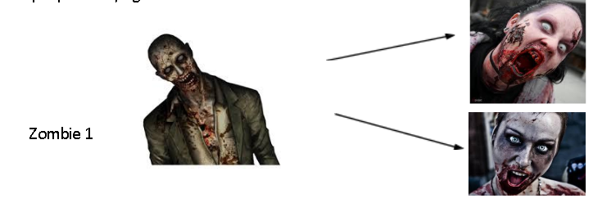
The Outbreak Part 1- Situation 2
There are 500,000 people in your town. On the first night of the zombie outbreak, 3 infected zombies enter your town and infect 2 people each. Every night after that the zombies go out and infect 2 people each, again.

Slide 7
The Outbreak Part 1- Situation 2
There are 500,000 people in your town. On the first night of the zombie outbreak, three infected zombies enter your town and infect two people each. Every night after that the zombies go out and infect 2 people each, again.
Night | 1
Total # Zombies | 6

Slide 8
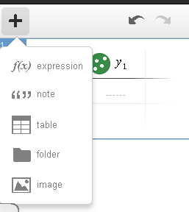
Write an equation to match this situation.
Create a graph of this situation on desmos (add a table). Use the snipping tool to cut and paste your graph below.

Slide 9
Look at your table and graph… What patterns do you see?

Slide 10
Explain similarities and differences between The Outbreak’s situation 1 and 2.

Slide 11
STEM Extension Questions

Slide 12
1. The rate of infection of any disease will eventually decrease because of many different factors. For the zombie outbreak, the main factors are lack of food (healthy humans) and lack of additional targets (again, healthy humans). For other epidemics or diseases those factors may include the development of a vaccine or the elimination of a vector (the source that carries and distributes the pathogen) such as mosquitos, rats, or other organisms. Historically, factors such as sanitation helped to control the rate of disease spread. What other factors can you think of?

Slide 13
2. "Virulence" is a measure of how effectively a disease-causing agent can spread through a population. Although the Zombie Virus isn't a real concern for us YET, name at least three more diseases that has a pretty high degree of virulence.

Slide 14
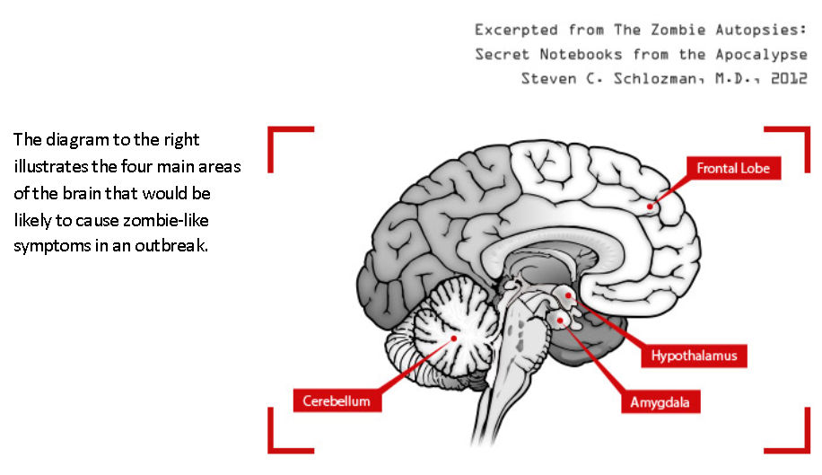

Slide 15
3. Name the resulting symptoms if each of these parts were affected.
Brain Part and Function | Zombie Symptoms
Cerebellum- Balance and Coordination
Hypothalamus- Appetite
Frontal Lobe- Intelligence and Problem Solving
Amygdala- Anger and Rage

Slide 16
4. What if a new zombie virus appeared that was almost the same as the original, but did not affect the cerebellum? Predict what the results would be.

Slide 17
5. What if the virus changed and neither the cerebellum nor the frontal lobe were affected? Predict the results.

