Slide 1
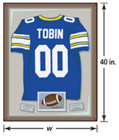
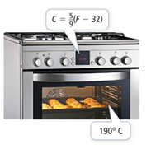
Example 1
Janet wants to calculate the time it takes to earn a certain amount of interest on a principal amount in an investment with simple interest. What equation can
she use? (Hint: help Janet solve for time)
A formula is an equation that states a relationship between one quantity and one or more other quantities. A literal equation is a formula where letters can represent both variables and known constants.
1.4 Literal Equations
Example 2
In a half hour, Sarah is meeting her friends at the lake, 6 mi from her house. At what average speed must she ride her bike to get there on time?
Example 3 A worker at a framing store is making a rectangular frame. He knows that the perimeter of the frame is 144 in. and the length is 40 in. How can he determine the width of frame?
Example 4
According to Teo’s bread recipe, he should bake the bread at 190°C for 30 minutes. His oven measures the temperature in °F. To what temperature in °F should he set his oven?

