Slide 1
Creating Coherence
The Role of Curriculum Mapping in Supporting Teacher Effectiveness
May 2014

Slide 2
Today’s Meet
Send questions to Today’s Meet at
http://today.io/nkx4

Slide 3








Big Idea: Coherence
21st Century Skills
Program Reviews
PGES
NGSS
MAP
Common Core
Notes:
We have a lot of new initiatives and expectations coming down from the state and national levels from PGES, to common core standards, to MAP, to Program Reviews, to name a few. The jumble of initiatives and expectations coming down from the state and national levels can feel overwhelming and disconnected.
It’s important to remember that these are not separate, unrelated entities. They all fit together in a coherent, meaningful way designed to move students forward to being College, Career, and Citizenship ready. We have to establish and create that coherence for our teachers (and ourselves!) in the way we approach and rollout these initiatives. If we approach in a disconnected way, or in isolation, our teachers and our students won’t get the benefit. Our visual icon for coherence will be a jigsaw puzzle to remind you that everything fits together to support the work of teacher effectiveness.

Slide 4

Essential Question
How does curriculum mapping fit into the larger picture of teacher effectiveness?
Enduring Skill
Domain 1: Planning and Preparation
Notes:
Our big idea of coherence leads to a natural essential question that we need to explore. “How does curriculum mapping fit into the larger picture of teacher effectiveness?”
Turn to Page 4 in your Framework for Teaching documents, which is an overview of the domains and components (if you have the older version, then it is on page 3). The Framework for Teaching, and the larger umbrella of PGES, will be our guiding document for teacher effectiveness through which we will create coherence with all of our initiatives. We have had exposure to the FfT this year through our monthly PGES sessions so all teachers should now have familiarity with its components, and we will start diving deeper into this document throughout this upcoming year.
Let’s take a moment to think about how our work with district curriculum mapping fits in to the larger picture of teacher effectiveness within the Framework for Teaching. (THINK) Take a moment to silently review the domains and components on page 3/4, and put a dot or checkmark beside the components that you think curriculum mapping most closely supports. (PAIR) There are 4 domains in the Framework for Teaching – Planning & Preparation, Classroom Environment, Instruction, and Professional Responsibilities. With your shoulder partner, share the components that you have marked and notice where they cluster under particular domains. Based on that, which DOMAIN does curriculum mapping most closely align and why? Discuss your thoughts with the person beside you. (SHARE) Randomly call on a few people to share their thoughts.
TEACHER ENDURING SKILL: DOMAIN 1 PLANNING AND PREPARATION
Curriculum mapping supports teachers as they develop and hone the enduring teaching skill of Planning and Preparation. Curriculum Mapping also supports and serves as a springboard into several components with Domain 3: Instruction, but whereas Domain 3 is more about instructional delivery, a curriculum map itself is truly about effective planning and preparation. Instruction is not at its best without intentional planning and preparation that is coordinated under a big picture and goes well beyond day-to-day lesson planning. A curriculum map serves as the big picture within which daily instructional decisions are made.

Slide 5
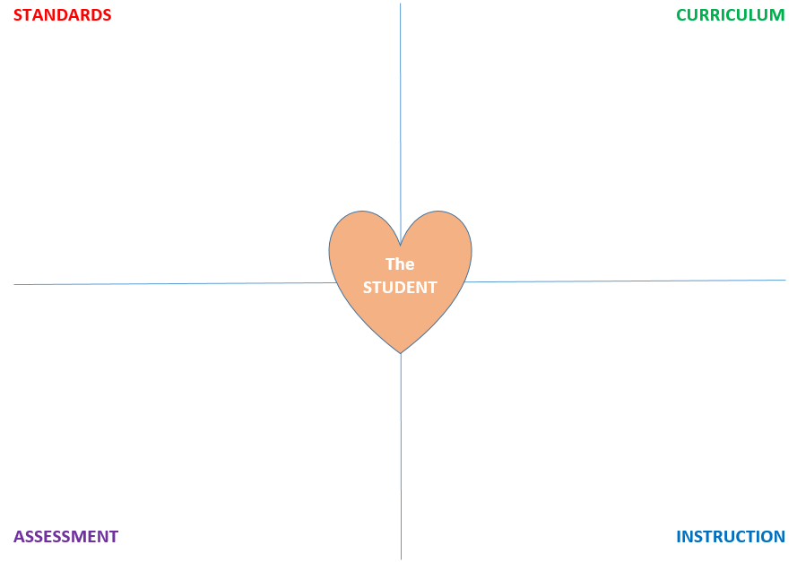
The Standards-Based Classroom
KCAS
Common Core
National Standards
Program of Studies
Integration Standards
NGSS
C-3 Framework
National A&H
Enduring Skills
According to the research of Robert Marzano, "A guaranteed and viable curriculum is the number one school-level factor impacting student achievement."
Mike Schmoker (2003) states, “Curriculum may be the single largest factor that determines how many students in a school will learn.”
The missing piece . . . ???
KPREP
MAP
AIMSweb monitoring
Learning Checks
Classroom Formative
Common Summative
Program Reviews
District Interim Benchmark
Project- and Problem- Based Tasks
Student Growth Goals
MTSS Tier 1
MTSS Tiers 2 & 3
LDC/MDC
Framework for Teaching
Best-Practice Strategies and Structures
Differentiation
TPGES
Notes:
(You have this slide as a notes page in your packet on page 3).
This graphic is adapted and greatly simplified from a presentation by Heidi Hayes Jacobs during her online Mapping to the Core bookmob session. The basic premise is that a standards-based classroom centers around the student with intentional implementation of curriculum, instruction, and assessment designed around rigorous standards. These pieces are all interconnected and of equal importance for a balanced classroom.
Hayes Jacobs had a blank diagram showing only the 4 pieces and the student in the center. I started thinking about what we as a state and district have going on in each of the 4 areas of standards, assessment, instruction and curriculum. When I started listing these out, something powerful happened. I was able to list a multitude of supports and guiding documents in every single area except . . . . curriculum. Which got me to thinking, why is this?
We must help teachers create coherence in their classrooms. Across our state and district, we have common standards in place at all schools through common core and KCAS, common standardized and adaptive assessments in place at all schools through KPREP and MAP, common instructional expectations and structures at all schools through MTSS and the Framework for Teaching, but nothing common in place at all schools in terms of curriculum expectations.
Unlike the other 3 areas of this diagram, there is very little from a state or national level coming down to districts and schools in terms of curriculum. What is out there is heavily vendor-created in the form of purchasable products. Why can’t the state just create or purchase one and give it to everyone, or why can’t we just “steal” one from another district?” The problem with these products is that the research on curriculum mapping strongly supports the notion that a curriculum must be personalized to the needs of the students in the district and school, and must be revisited, revised, and updated regularly. A purchased product doesn’t lend itself to these things. It really IS up to the district and schools to create and support a cohesive curriculum. (Marzano and Schmoker quotes reiterate the importance).

Slide 6
The “Why”
Purposes and Advantages of a District Map
Provides a minimum expectation so that every kid has equal access to opportunity for learning
Provides the “what” so the teacher can focus on the “how”
Establishes expectations for learning for all students, and for instruction for all teachers
Provides a springboard for development of effective Tier 1 instruction
Provides a basis for development and analysis of common summative (school) and interim benchmark (district) assessments
Provides a common language for educators
Reduces learning gaps created by transiency
Reduces gaps created by oversight in planning and preparation
The bottom line: The lack of implementation of a common curriculum promotes and perpetuates achievement gaps.
Notes:
There are many purposes and advantages of adopting and adhering to a district curriculum map, especially in a district our size. These advantages are listed on page 4 of your packet, so please find that page in your packet. This is not an all-inclusive list and you and your teachers may have even more to add. Take a moment and read through the list of advantages, placing a star beside the advantages that most closely resonate with the needs of your students, teachers, and school.
Despite the advantages, teachers and schools may still have some concerns during the transition to a common district curriculum. Think about your teachers and the questions and concerns they might have about curriculum maps. It is important to think ahead to the questions and concerns that teachers might voice when adopting a new curriculum, especially if it will impact their currently designed units and lessons. For example, one question might be “Will I still have creative freedom in designing my lessons?” Another might be, “How do my current lessons and resources fit in with the maps, or will I have to start over?” Jot these down on the right side of the chart, see if you can glean answers throughout the session today, and submit any burning or unanswered questions or concerns to the Today’s Meet link before you leave today.
Arguably, the most important role a curriculum map serves is providing a MINIMUM expectation for opportunity for learning. If students don’t have the opportunity to learn a minimum set of articulated expectations, then we have automatically created achievement gaps. The lack of implementation of a common curriculum promotes and perpetuates achievement gaps.

Slide 7
The “What”
Curriculum Maps ARE NOT . . .
Curriculum Maps ARE . . .
standards documents
stand-alone pacing guides
a program or product
a textbook
a set of lessons
set in stone
an intentionally designed, sequential learning progression through the required standards
used to guide decisions about instructional resources and materials
a springboard for lesson and assessment design
flexible, adaptable, and fluid
Curriculum maps are never considered "done," nor is having maps the ultimate goal of mapping. Maps are a by-product of mapping. The term mapping is a verb. It constitutes active engagement and collegial participation in on-going curriculum work. Curriculum mapping does not perceive education as a static environment since learning, and learning about learning, is in continual motion.
Heidi Hayes Jacobs, www.curriculummapping101.com
Notes:
In hindsight, the timing of our mapping release is perfect with the onset of the state-wide TPGES implementation. It will create a need for teachers to revisit their current instructional sequences, standards sets, and resources and will cause a “deep dive” into the standards. These are all important parts of accomplished and exemplary teachers in TPGES.
Just as a recap of our discussion thus far, let’s revisit what curriculum maps are and are not . . .
The Hayes Jacobs quote is important because mapping MUST be seen as a process by all of us. This is not something that is ever “finished.” The work today is only the tip of the iceberg in a long process of instructional growth.

Slide 8
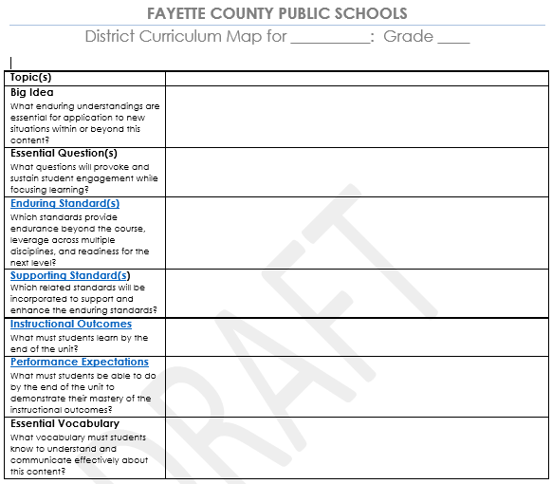
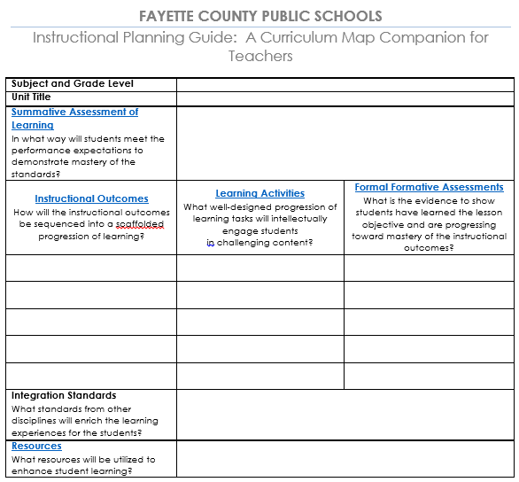
Format of the Maps
Part 1: Today’s Focus!
Part 2: On-Going 2014-2015
Completed by District
Completed by School
Notes:
Now that we have gone through the theory behind curriculum mapping, let’s start putting a face to it. Today is Phase 1 of the curriculum mapping rollout
In your packet, you have a copy of the blank template so you can see all the components of the map. In your folders, you have copies of the 2nd/8th grade ELA, science and math maps which show examples of what the completed product looks like for each topic of study.
Part 1 is the actual district curriculum map. This section has been the focus of the Design and Development teams, and this is what we will be focusing on today. These sections will be completed in their entirety and will comprise the common map for the district. Teachers must have a thorough understanding of the components and parts of the map so they can utilize them when planning and preparing for their daily interactions with students. Remember that the map provides the big picture of learning for the district.
Part 2 is the instructional planning guide, which is a unit and lesson planning tool for teachers and schools. This will be one of the focuses of the PGE Coaches this year, building their capacity to support teachers in the development of instruction that meets the accomplished and exemplary levels in the Framework for Teaching. (Domains 1 and 3). Part 2 will look different across schools and classrooms, with different instructional strategies and activities, depending on the needs of the students.
This is a long-term project and we need everyone to be prepared to think of it as such. Although everyone is itching to jump straight in to Part 2, it is incredibly important not to “skimp” on teacher’s understanding and internalization of Part 1. Part 1 is the final destination that establishes the acceptable baseline for rigor, and Part 2 is the path to get there.
Suggested pacing guides are also a part of this work. We will discuss those when we return to the large group after our rotations.

Slide 9
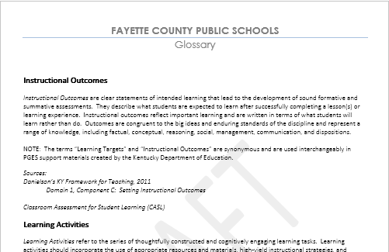
Glossary (Under Construction)
Hyperlinked to headings in map
Description of term
TPGES Connection
Research and Sources for Information
Notes:
Another feature of the maps is that they are designed to be interactive. Within each map is an embedded glossary that will contain hyperlinks to descriptions, research, resources, and connections to the Framework for Teaching. The development of this part will not be complete until over the summer, but in your folders, the sample maps have the draft glossary attached.
For that reason, the maps are intended to be used mostly electronically as we will update those periodically as new resources and research become available.

Slide 10

Instructional Outcomes
Today, I will learn how to
define the pieces of the curriculum map, and
describe how those pieces connect to and support effective teaching practices within the Framework for Teaching
so that I can support the teachers in my school with implementation of the maps over the 2014-2015 school year.
Notes:
In just a moment, you will begin rotating through your informational sessions. Here are the instructional outcomes for today. By the time you leave, you should feel fairly comfortable defining the pieces of the curriculum map and describing how those pieces connect to and support the FtT so that you can support your teachers in moving forward with this work.

Slide 11

Rotation Schedule
Refer to your packet for assigned rotation groups and times, and don’t forget about Today’s Meet!
Topic | Presenter | Room
Big Ideas & Essential Questions | Natalee Feese | 202
Enduring and Supporting Standards & Enduring Skills | Sabrina Reed | Choir Room
Instructional Outcomes | Lori Bowen | 131
Performance Expectations | David Helm | 111
Return to this room at 11:00 for “Putting it All Together” with Liz Tronoski!
Notes:
We are getting ready to experience the a condensed version of the life of a student today by transitioning and rotating through different “classrooms” today. You will rotate through 4 sessions, each focused on a section or two of the curriculum map, plus a 45-minute closing session. You have only 5 minutes of transition time before the tardy bell rings, so it is important that you transition QUICKLY because we want everyone to be able to go to lunch on time, and we can’t go to lunch until we finish. During this time, you will be taking a deeper dive into each of these pieces of the map. You will see how all of the maps are cohesively designed around the same language and format, allowing for easier integration of content and creating a common language among departments and content areas.
These sessions are designed like a train-the-trainer to allow you to take back the information and share with your teachers and staff members. Each rotation is about 20 minutes in length. You can combine them and roll through all of them like we are doing today, or you can take them one-by-one with your staff and focus on one area at a time. All materials, handouts, and powerpoints are located on the iSchool site (instructions for accessing are on the front page of your participant packet).
Please continue to use the Today’s Meet site throughout the day today to submit your unanswered questions or comments throughout the day. We will compile answers to these and send out to everyone after the last group meets on May 15. Please proceed to your next session, which begins in exactly 5 minutes.

